Slide 1
Unit 1 :
Object Oriented Javascript

Slide 2
Topics
Objects
Functions
Anonymous functions
Methods
Constructors
Closures
Modules
Inheritance
Classical
Prototypal
Functional
Design patterns
Singleton
Cookies
Exception handling
AJAX
Introduction to frameworks
JSON

Slide 3
Objects
The simple types in javascript are numbers, strings, booleans (true or false), null and undefined
All other values are Objects
Numbers, strings and booleans are object like, in that they have methods, but they are immutable
Objects in javascript are mutable keyed collections
In javascript arrays are objects, functions are objects, regular expressions are objects and of-course objects are objects

Slide 4
Objects
An object is a container of properties, where a property has a name and value.
A property name can be any string, a property value can be any javascript value except for undefined
Objects in javascript are class free
Javascript includes a prototype linkage feature that allows one object to inherit the properties of another

Slide 5
Object Literals
Object literals provide a very convenient notation for creating new object values
An object literal is a pair of curly braces surrounding zero or more name/value pairs
For Ex:
var empty_object = {};
var fullName = {
first_name: “Krishna”,
last_name: “Kumar”
};

Slide 6
Object Literals
Values can be retrieved from objects by wrapping a string expression in a [ ] suffix
However, the . Notation is preferred because it is more compact and reads better
For Ex: [From the previous example given]
fullName[“first_name”];
OR
fullName.first_name (preferred option)

Slide 7
Objects
A value in an object can be updated by assignment
If property value already exists in the object, the property value is replaced, else it is augmented
For Ex:
fullName.first_name = “Prasanna”;
fullName.middle_name = “Shandilya”;

Slide 8
Objects
Objects are passed around by reference
They are never copied
For Ex:
var completeName = fullName;
completeName.middle_name = “Rao”;
var middle = fullName.middle_name;
//middle will be “Rao” because fullName and
//completeName are references to same object

Slide 9
Objects Prototype
Every object is linked with a prototype object from which it can inherit properties
All objects created from object literals are linked to Object.prototype, that comes standard with javascript
When you select a new object, you can select the object that should be its prototype

Slide 10
Exercise
For Ex: We will add a create method to the Object function
The create method will create a new object, that uses an old object as prototype

Slide 11
Objects Prototype
If (typeof Object.create != ‘function’) {
Object.create = function(o) {
var F = function() {};
F.prototype = o;
return new F();
};
}
var anotherName = Object.create(fullName);
anotherName.first_name = “Subramanian”;
anotherName.middle_name = “S”;
anotherName.last_name = “Iyer”;

Slide 12
Objects Prototype
Prototype link is used only in retrieval
It has no effect on updating. Object’s prototype is not touched, when we make changes to an object
If the property name is not there in the object, javascript attempts to search in the object’s prototype
If still not available, it would search in its own prototype
If it exists no where in the chain, then undefined value is returned
This process is called delegation

Slide 13
Enumeration and Delete
For in statement can loop over all of the property names in an object
Var name
for (name in fullName) {
if(typeof fullName[name] != ‘function’) {
document.writeln(name + ‘:’ + fullName[name]);
}
}
Delete operator can be used to remove a property from an object
delete fullName.middle_name;

Slide 14
Function Objects
Functions are fundamental modular unit of javascript
They are used for code reuse, information hiding and composition
Functions in javascript are objects
Every function object is created with a prototype property. Its value is an object with a constructor property whose value is the function
Every function is created with two additional hidden properties, the context of the function and the code that implements the function’s behavior

Slide 15
Function Objects
Since functions are objects, they can be used like any other value
They can be stored in variables, objects and arrays
Functions can be passed as arguments to functions and functions can be returned from functions
Also, since functions are objects, functions can have methods
The special thing about functions is that it can be invoked

Slide 16
Function Objects
Function objects are created with function literals
//Create a variable called add and store a function that //adds two numbers
var add = function (a,b) {
return a + b;
};
A function literal has four parts
First : Reserved word function

Slide 17
Function Objects
Second: The optional second part is a function’s name.
The function can use its name to call recursively
If a function is not given a name, then it is said to be anonymous
Third: Set of parameters of the function, wrapped in parentheses
Within the parentheses, is a set of zero or more parameter names, separated by commas
The names will be defined as variables in the function
Fourth: Set of statements wrapped in curly braces.
These statements are the body of the function
Executed when function is invoked

Slide 18
Function Invocation
Invoking a function suspends the execution of current function, passing control and parameters to the new function
In addition to the declared parameters, every function receives two additional parameters: this and arguments
There are four patterns of invocation in javascript
Method invocation pattern
Function invocation pattern
Constructor invocation pattern
Apply invocation pattern

Slide 19
Function Invocation
Method invocation pattern
When a function is stored as a property in an object, we call it a ‘method’
When a method is invoked, ‘this’ is bound to that object
var myObject = {
value : 0,
increment : function (inc) {
this.value += inc;
}
}

Slide 20
Function Invocation
myObject.increment();
document.writeln(myObject.value) //output is 1
myObject.increment(2);
document.writeln(myObject.value) //output is 3
A method can use ‘this’ to access the object so that it can retrieve values from the object or modify the object
Methods that get their object context from ‘this’ are called ‘public methods’

Slide 21
Function Invocation
Function invocation pattern
When a function is not the property of an object, then it is invoked as a function
var sum = add(3,4);
When a function is invoked with this pattern, ‘this’ is bound to the global object
Disadvantage of it being bound to global object is, method cannot employ an inner function to help it do its work because the inner function does not share its access to the object

Slide 22
Function Invocation
Workaround for the problem is by assigning value of ‘this’ to a variable
myObject.double = function() {
var that = this;
var helper = function() {
that.value = add(that.value, that.value);
};
helper();
};
//Invoke double as a method
myObject.double();
document.writeln(myObject.value);

Slide 23
Function Invocation
Constructor invocation pattern
Javascript is a prototypal inheritance language
Offers an object making syntax very similar to that of the classical language
If a function is invoked with the ‘new’ prefix, then a new object will be created with a hidden link to the value of the function’s prototype member and ‘this’ will be bound to that object
Functions that are intended to be used with ‘new’ prefix are called constructors
By convention they are kept with a capitalized name

Slide 24
Function Invocation
For Ex:
var Car = function(_name, _mpl, _color)
{
this.name = _name;
this.mpl = _mpl;
this.color = _color;
this.showColor = function() {return this.color;};
}
myCar = new Car(“Maruti”, 15, “Red”);
myCar.showColor();

Slide 25
Function Invocation
Apply invocation pattern
Apply method lets us construct an array of arguments to use to invoke a function
It also lets us choose the value of ‘this’
Method takes two parameters, first is the value that should be bound to ‘this’ and second is the array of parameters
var array = [3,4];
var sum = add.apply(null, array); //sum is 7

Slide 26
Function Arguments
Bonus parameter that is available to all the functions when they are invoked is the arguments array
Gives functions the access to all of the arguments that were supplied even the ones that were not assigned to parameters
For Ex:
var sum = function() {
var i, sum = 0;
for (i = 0; i < arguments.length; i++) {
sum += arguments[i];
}
}
document.write(sum(4,8,16,25,46,59);

Slide 27
Closures
We have to understand closures by an example and also looking into scope defined in javascript
Inner functions get access to the parameters and variables of the functions they are defined within (with the exception of this and arguments)
Let us look at an example. Supposing we want to protect the value from unauthorized changes in the below mentioned example
Instead of initializing myObject with an object literal, we will initialize myObject by calling a function, that returns an object literal

Slide 28
Closures
var myObject = function () {
var myValue = 0;
return {
increment: function(inc) {
myValue+=typeof inc == ‘number’ ? inc:1
},
getValue: function() {
return myValue;
}
};
}();
The function defines a value variable
The variable is always available to increment and getValue methods, but the function’s scope keeps it hidden from rest of the program

Slide 29
Closures
We are not assigning function to myObject, but are assigning the result of invoking that function
Now, when we call the function
myObject.increment(1);
document.write(myObject.getValue()); //Output is 2
When we call, var myObject = function() ……, an object is returned back with increment and getValue methods
A reference to that object is stored in myObject
The getValue and increment method, still has previleged access to value property. It has access to the parameter itself and not to the copy of it

Slide 30
Closures
This is because function has access to the context in which it was created
This is called “Closure”

Slide 31
Modules
A “module” is a function or object that presents an interface but that hides its state and implementation
General pattern of a module is
a function that defines private variables and functions
creates privileged functions which, through closure, will have access to the private variables and functions
returns the privileged functions or stores them in an accessible space
Module pattern takes advantage of function scope and closure to create relationships that are binding and private

Slide 32
Modules
Use of modules can eliminate global variables
Promotes information hiding and other good design practices
For Ex: Let us consider that we want to make an object that produces a serial number
An object that produces unique strings
A unique string is made up of two parts, a prefix and a sequence number
Objects comes with method for setting the prefix and sequence number, and a gensym method that produces unique string

Slide 33
Modules
var serial_maker = function() {
var prefix = ‘’;
var seq = 0;
return {
setPrefix: function(p) {
prefix = String(p);
},
setSeq: function(s) {
seq = s;
},
gensym: function() {
var result = prefix + seq;
seq+=1;
return result;
}
};
};
var sequer = serial_maker();
sequer.setPrefix(‘A’);
sequer.setSeq(1000);
var unique = sequer.gensym(); //Output is A1000

Slide 34
Inheritance
Feature of object oriented programming
One entity inherits certain properties and functionalities from another entity
Classical inheritance provides two useful services
It is a form of code reuse
Only the differences have to be defined
Includes specification of a system of types.
Casting is avoided to a large extent, which ensures safety benefits of a type
In classical inheritance, objects are instances of classes and a class can inherit from another class
Javascript is a prototypal language, which means that objects inherit directly from other objects

Slide 35
Inheritance - Pseudoclassical
Objects don’t inherit directly from objects, but objects are produced by constructor functions
When a function object is created, the Function constructor that produces the function object runs code like this
this.prototype = { constructor: this };
The new function object is given a prototype property whose value is an object containing a constructor property whose value is the new function object
The prototype object is the place where inherited traits are to be deposited

Slide 36
Inheritance - Pseudoclassical
var Mammal = function(name) {
this.name = name;
Mammal.prototype.getname = function() {
return this.name
};
Mammal.prototype.says = function() {
return this.saying || 'Nothing';
};
};
var MyMammal = new Mammal(’Elephant');
var name = MyMammal.getname(); //ouput Elephant
var say = MyMammal.says(); //output Nothing
Var Cat = function(name) {
this.name = name;
this.saying = ‘meow’;
Cat.prototype.getname = function(){
return this.says() + ‘ ‘ + this.name;
};
};
Cat.prototype = new Mammal();
var myCat = new Cat(‘Pussy Cat');
var catname = myCat.getname(); // output meow Pussy Cat
Var catsays = myCat.says(); // meow

Slide 37
Inheritance - Pseudoclassical
We have constructor functions which act as classes
All properties are public here
If we forget the new keyword, this will be bound to the global object
Therefore, new is very important and in-order to identify a constructor we start the word with a capital letter
For E: var mycat = new Cat(name);

Slide 38
Inheritance - Prototypal
In prototypal inheritance, we dispense with classes and focus on objects
Is conceptually simpler than classical inheritance – a new object can inherit the properties of an old object
For Ex:
var myMammal = {
name: ‘Elephant the mammal’,
getname : function() {
return this.name;
};
says : function() {
return this.saying || ‘Nothing’;
};
};

Slide 39
Inheritance - Prototypal
If (typeof Object.create != ‘function’) {
Object.create = function(o) {
var F = function() {};
F.prototype = o;
return new F();
};
}
var myCat = Object.create(myMammal);
myCat.name = ‘Pussy Cat’;
myCat.saying = ‘meow’;
myCat.getname = function() {
return this.says() + ‘ ’ + this.name;
};
myCat.getname(); // output meow Pussy Cat

Slide 40
Inheritance - Functional
One weakness in the patterns we have seen so far for inheritance, is that all properties are public
No private variables or methods
There is an alternative in an application of the module pattern
We start by making a function that will produce objects
The function contains four steps

Slide 41
Inheritance - Functional
Creates a new object.
Many ways to make an object. Can make an object literal or it can call a constructor with new prefix or call the create method
Optionally defines private variables and methods
These are just ordinary vars
It augments that new object with methods
Those methods will have privileged access to the parameters and vars defined in second step
Returns the new object

Slide 42
Inheritance - Functional
Pseudo code template for functional constructor
var constructor = function (spec, my) {
var that, other private instance variables;
my = my || {};
// Add shared variables and functions to my
that = a new object;
// Add privileged methods to that
return that;
};

Slide 43
Inheritance - Functional
‘spec’ object contains all information that the constructor needs to make an instance
Contents of the spec could be copied into private variables or transformed by other functions
Methods can access information from the spec as they need it
‘my’ object is a container of secrets that are shared by the constructors in the inheritance chain
Use of my object is optional
Let us look at the mammal example now

Slide 44
Inheritance - Functional
var mammal = function (spec) {
var that = {};
that.getname = function() {
return spec.name;
};
that.says = function() {
return spec.saying || ‘Nothing’;
};
return that;
};
var myMammal = mammal({name : ‘Herb’});

Slide 45
Inheritance - Functional
In pseudoclassical pattern, Cat constructor function had to duplicate work that was done by Mammal constructor, but here Cat constructor allows Mammal do most of the work of object creation
Cat has to concern itself with the difference
var cat = function(spec) {
spec.saying = spec.saying || ‘meow’;
var that = mammal(spec);
that.getname = function() {
return that.says() + ‘ ‘ + spec.name;
};
return that;
};
var myCat = cat({name: ‘Pussy Cat’});

Slide 46
Inheritance - Functional
Functional pattern has a great deal of flexibility
Requires less effort than the pseudoclassical pattern
Better encapsulation and information hiding and access to super methods
If all of the methods of the object make no use of this or that, then the object is durable
A durable object cannot be compromised

Slide 47
Design Patterns - Singleton
Patterns are about interfaces and relationships rather than implementation
Pattern that we are going to discuss is
Singleton
Singleton is a creational design pattern. Focus is on creating objects
It is useful when you want to make sure there is only one object of a given kind or class
In a classical language, this would mean that an instance of a class is only created once and any subsequent attempts to create new objects of the same class would return the original instance

Slide 48
Design Patterns - Singleton
In JavaScript, because there are no classes, a singleton is the default and most natural pattern
Every object is a single object
If you don't copy it and don't use it as a prototype of another object, it will remain the only object of its kind
The most basic implementation of the singleton in Javascript is the object literal
var single = {};
If you want to use class-like syntax and still implement the singleton, things can become a bit more interesting

Slide 49
Design Patterns - Singleton
Functions are objects and they have properties
You can assign the single instance to a property of the constructor function
function Logger() {
if (typeof Logger.single_instance === "undefined") {
Logger.single_instance = this;
}
return Logger.single_instance;
};
var a = new Logger(), a will point to the newly created Logger.single_instance property
var b = new Logger() will result in b pointing to the same Logger.single_instance property

Slide 50
Design Patterns - Singleton
The only drawback is that the property of the Logger constructor is publicly visible, so it can be overwritten at any time
In such cases, the single instance can be lost or modified
The solution to the problem of overwriting the publicly-visible property is to not use a public property, but a private one
Closure and module pattern will help us achieve this

Slide 51
Question time
Please try to limit the questions to the topics discussed during the session. Thank you.

Slide 52
Cookies
Cookies were originally invented by Netscape to give 'memory' to web servers and browsers
The HTTP protocol, which arranges for the transfer of web pages to your browser and browser requests for pages to servers, is state-less
The server cannot remember if you identified yourself when you want to access protected pages
Cookies were invented to solve this problem
Cookies are easy to maintain and very versatile

Slide 53
Cookies
A cookie is nothing but a small text file that's stored in your browser. It contains some data
A name value pair containing the actual data
An expiry date after which it is no longer valid
Domain and path of the server it should be sent to
name – value
You will search for this name when reading out the cookie information
expiry date
Each cookie has an expiry date after which it is trashed
If you don't specify the expiry date the cookie is trashed when you close the browser
This expiry date should be in UTC (Greenwich) time

Slide 54
Cookies
domain and path
Each cookie also has a domain and a path
The domain tells the browser to which domain the cookie should be sent
If you don't specify, the domain of the page that sets the cookie is considered
Can also apply to sub-domain
Path is usually ‘/’ else it can be /admin [specific path]
document.cookie
Cookies can be created, read and erased by JavaScript
They are accessible through the property document.cookie
For Ex:
document.cookie = ‘name=krishna; expires=Thu, 2 Aug 2001 20:47:11 UTC; path=/‘

Slide 55
Cookies
If I want to set another cookie, I again do
document.cookie = ‘email=kk@pratian.com; expires=Fri, 3 Aug 2001 20:47:11 UTC; path=/'
The first cookie is not overwritten, instead the second one is added to document.cookie
To read out a cookie you have to treat document.cookie as a string and search for certain characters like ;
See DemoCookie.html

Slide 56
Question time
Please try to limit the questions to the topics discussed during the session. Thank you.

Slide 57
Exception handling
Errors find their way into your code most often
Sometimes they are runtime errors caused by unpredicted scenarios
Sometimes the errors are just incorrect behavior of your code, popularly known as bugs
Globally handled errors
window object has an event called onerror whenever there is any unhandled error in the page
We can write an event handler and get to know about the error
onerror event will pass 3 parameters to the event handler
Actual message
URL of the file containing the error
Line no in the file where the error exists

Slide 58
Exception handling
Returning true tells the browser that you have taken care of the problem
If you return false instead, the browser will proceed to treat the error as unhandled, showing the error message and the status bar icon
window.onerror = function (message, url, lineNo)
{
alert( 'Error: ' + message + '\n Url: ' + url + '\n Line Number: ' + lineNo);
return true;
}

Slide 59
Exception handling
Structured error handling
The best way to deal with errors is to detect them the closest possible to where they happen
JavaScript implements structured error handling, via the try...catch...finally block, also present in many other languages
Syntax
try
{
statements;
}
catch (error)
{
statements;
}
finally
{
statements;
}

Slide 60
Exception handling
Structured error handling
The error object has two important properties : name and message
The message property contains the error message description
The name property contains the kind of error that happened
try
{
var name = window.prompt('Type your name', '');
alert('Your name has ' + name.llength + ' letters.');
}
catch (error)
{
alert(error.message);
}
finally
{
//do cleanup
}

Slide 61
Exception handling
Structured error handling
The throw statement will forward the error as if we never had this try...catch...finally block
Throwing our own errors
We can use the throw statement to throw our own types of errors
The only recommendation is that our error object also has a name and message properties to be consistent in error handling
var newError = new Error();
newError.name = “ColorError";
newError.message = “The given color is not a valid color value.‘’;
throw(newError);
or
throw new Error(“The given color is not a valid color value.‘’);

Slide 62
Question time
Please try to limit the questions to the topics discussed during the session. Thank you.

Slide 63
AJAX
The term AJAX is a pseudo-acronym for "Asynchronous JavaScript And XML”
Now used much more broadly to cover all methods of communication with a server using JavaScript
Ajax is not a technology, but its really several technologies, each flourishing in its own right and coming together in powerful new ways
Ajax is not always asynchronous and does not always involve XML

Slide 64
AJAX
Ajax incorporates
Standards based presentation using XHTML and CSS
Dynamic display and interaction using the Document Object Model
Data interchange and manipulation using XML and XSLT
Asynchronous data retrieval using XMLHttpRequest
Javascript binding everything together
Earlier we had to wait for the server to process the request sent from a form in one page and then would be redirected to the next page
Ajax attempts to solve this problem by letting javascript communicate directly with the server
You can get information from the server without having to reload the page

Slide 65
AJAX
XMLHttpRequest
The mechanism for sending data to and retrieving data from the server with Ajax is the XMLHttpRequest object
Simple XMLHttpRequest() constructor is used to create the object
xmlhttp = new XMLHttpRequest();
Prior to IE 7.0 browsers, the same object has to be created using xmlhttp = ActiveXObject("MSXML2.XMLHTTP.3.0");

Slide 66
AJAX - GET
<html>
<body>
<script language="javascript" type="text/javascript">
function ajaxFunction(){
var ajaxRequest;
try{
ajaxRequest = new XMLHttpRequest();
} catch (e){
try{
ajaxRequest = new ActiveXObject("Msxml2.XMLHTTP3.0"); }
catch (e){alert("Your browser broke!"); return false;
}
}
ajaxRequest.onreadystatechange = function(){
if(ajaxRequest.readyState == 4 && ajaxRequest.status == 200){
document.myForm.lastname.value = ajaxRequest.responseText;
}
}
ajaxRequest.open("GET", “ajax_info.txt", true);
ajaxRequest.send(null);
}
</script>
<form name='myForm'>
Name: <input type='text' onChange="ajaxFunction();" name='username' /> <br />
Last Name: <input type='text' name=‘lastname' />
</form>
</body>
</html>

Slide 67
AJAX - POST
<html>
<body>
<script language="javascript" type="text/javascript">
function ajaxFunction(){
var ajaxRequest;
try{
ajaxRequest = new XMLHttpRequest();
} catch (e){
try{
ajaxRequest = new ActiveXObject("Msxml2.XMLHTTP3.0"); }
catch (e){alert("Your browser broke!"); return false;
}
}
ajaxRequest.onreadystatechange = function(){
if(ajaxRequest.readyState == 4 && ajaxRequest.status == 200){
document.myForm.lastname.value = ajaxRequest.responseText;
}
}
ajaxRequest.open(“POST", “ajax.asp”, true);
xmlhttp.setRequestHeader("Content-Type","application/x-www-form-urlencoded;"); xmlhttp.send("FirstName=krishna&LastName=Kumar");
}
</script>
<form name='myForm'>
Name: <input type='text' onChange="ajaxFunction();" name='username' /> <br />
Last Name: <input type='text' name=‘lastname' />
</form>
</body>
</html>

Slide 68
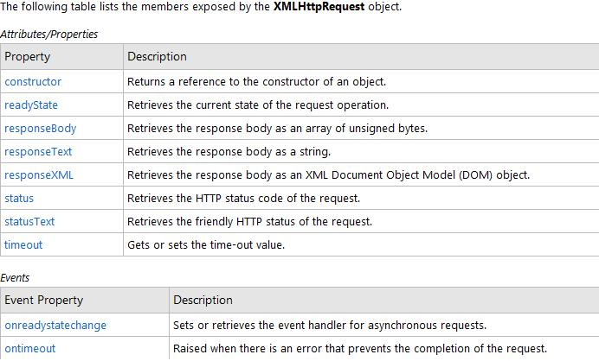
AJAX

Slide 69
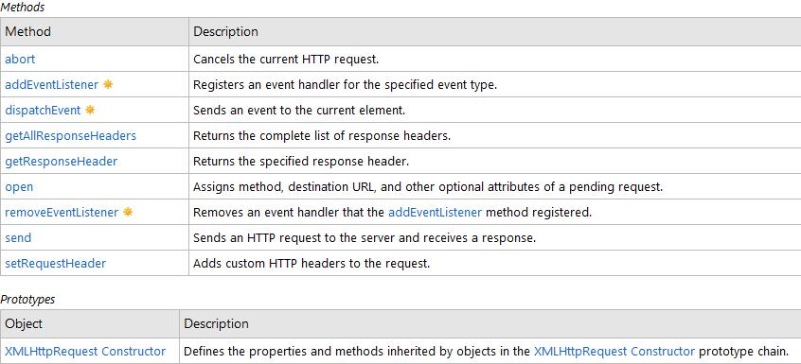
AJAX

Slide 70
AJAX
Handling the response
When using asynchronous calls, we cannot be sure when the response will come
We must write code that waits for the response and handles it when it arrives
We do this with a callback function
Callback functions are functions that are triggered by some event
xmlhttp.onreadystatechange=function()
{
//Do something here
}
The xmlhttp object's readyState property holds the current state of the response

Slide 71
AJAX
readystate property values
0 – Request Uninitialized
1 – Request setup
2 – Request sent
3 – Request in process
4 – Request Completed
status property values
200 – OK
302 – Found
403 – Forbidden
404 – Not found
500 – Internal server error

Slide 72
AJAX - Frameworks
JavaScript frameworks can serve several purposes:
Abstraction.
Writing JavaScript is notoriously difficult in large part because of the browser and platform differences.
Browser compatibility is handled well by these frameworks
Widget Libraries
Many frameworks provide libraries of pre-written, customizable widgets (expandable trees, accordions, autocompletes, drag-and-drop controls, etc.).
Development Structure
Some frameworks make it easier to create structured, object-oriented Ajax applications

Slide 73
AJAX - Frameworks
Dojo
Is a multi-purpose JavaScript toolkit that allows you to easily build dynamic capabilities into web pages and any other environment that supports JavaScript
The documentation for Dojo is relatively good compared with other frameworks
The latest version of Dojo is freely available for download at http://dojotoolkit.org/downloads
Dojo is included with your class files (/dojo/dojo.js)

Slide 74
AJAX - Frameworks
<script type="text/javascript" src=“dojo/dojo.xd.js"></script>
<script type="text/javascript">
var OutputDiv;
function GetEmployeeList(URL)
{
OutputDiv = document.getElementById("EmployeeList"); OutputDiv.innerHTML="<h2>Loading...</h2>";
dojo.xhrPost( { url: URL, handleAs: "text", load: Display });
}
function Display(DATA)
{
OutputDiv.style.display="block";
if (DATA.indexOf("Failed") != -1) { OutputDiv.className="Warning"; OutputDiv.innerHTML=DATA;
}
else {
OutputDiv.innerHTML = DATA;
}
}
window.onload = function() {
GetEmployeeList("../EmployeeList.jsp");
} </script>

Slide 75
AJAX - Frameworks
Prototype
Is a multi-purpose JavaScript toolkit that aims to ease development of dynamic web applications
The latest version of Prototype is freely available for download at http://www.prototypejs.org/download as a .js file
<script language="javascript" src="prototype.js"></script> include this in your files
Syntax
new Ajax.Request(URL,
{
method: "get", //or "post"
onComplete: CallBackFunction,
parameters: "param1=value&param2=value&param3=value"
});

Slide 76
AJAX - Frameworks
<script type="text/javascript" src=“prototype/prototype.js"></script>
<script type="text/javascript">
var OutputDiv;
function GetEmployeeList(URL)
{
OutputDiv = document.getElementById("EmployeeList"); OutputDiv.innerHTML="<h2>Loading...</h2>";
new Ajax.Request(URL, { method: "post", onComplete: Display });
}
function Display(REQ)
{
OutputDiv.style.display="block";
if (REQ.responseText.indexOf("Failed") != -1) { OutputDiv.className="Warning"; OutputDiv.innerHTML=REQ.responseText;
}
else {
OutputDiv.innerHTML = REQ.responseText; }
}
window.onload = function() {
GetEmployeeList("../EmployeeList.jsp");
} </script>

Slide 77
Question time
Please try to limit the questions to the topics discussed during the session. Thank you.

Slide 78
JSON
JSON is a lightweight format for exchanging data between the client and server
Often used in Ajax applications
Simplicity
Format based on JavaScript object literals
Array literals are created with square brackets
var Cars = [“Maruti",“Hyundai",“Toyota",“Ford"];
or
var Cars = Array(“Maruti",“Hyundai",“Toyota",“Ford“);
Object literals are created with curly braces
var Car = {
make: “Toyota”,
name: “Corolla”,
variant : “Diesel”
}

Slide 79
JSON
Or
var Car = new Object();
Car.make = “Toyota”;
Car.name = “Corolla”;
Car.variant = “Diesel”;
Properties can be referenced using dot notation or bracket notation
alert(Car[“make”]); or alert(Car.make);
Arrays in objects
var Car = {
make: “Toyota”,
name: “Corolla”,
variant : “Diesel”,
colors : [“Red”, “Black”, “White”, “Silver”]
}

Slide 80
JSON
Objects in arrays
var Cars = [
{
make: “Toyota”,
name: “Corolla”,
variant : “Diesel”,
colors : [“Red”, “Black”, “White”, “Silver”]
},
{
make: “Ford”,
name: “Figo”,
variant : “Diesel”,
colors : [“Blue”, “Black”, “Brown”, “Silver”]
}
]

Slide 81
JSON
JSON syntax is like JavaScript's object literal syntax
But the objects cannot be assigned to a variable
JSON just represents the data itself
So Cars object would be defined as
{
make: “Toyota”,
name: “Corolla”,
variant : “Diesel”,
colors : [“Red”, “Black”, “White”, “Silver”]
}
JSON is just a string of text and not an object in and of itself
Needs to be converted to an object before we use it

Slide 82
JSON
We will use a JSON parser to do the same
We can download the JavaScript JSON parser at http://www.json.org/json.js
JSON.parse(strJSON) -
converts a JSON string into a JavaScript object
JSON.stringify(objJSON) -
converts a JavaScript object into a JSON string

Slide 83
JSON
The process for sending data between the browser and server with JSON is
Client side
Create a JavaScript object using the standard or literal syntax.
Use the JSON parser to stringify the object.
Send the URL-encoded JSON string to the server as part of the HTTP Request. This can be done using the HEAD, GET or POST method by assigning the JSON string to a variable
Server side
Decode the incoming JSON string and convert the result to an object using a JSON parser for the language of your choice
At http://www.json.org, you'll find JSON parsers for many modern programming languages

Slide 84
Question time
Please try to limit the questions to the topics discussed during the session. Thank you.

Slide 85
Fetching DOM elements
getElementsByName(“name”);
getElementById(“id”);
getElementsByTagName(“tag”);

Slide 86
Adding DOM elements
elementNode.appendChild(newNode);
elementNode.insertBefore(new_node, existing_node);

Slide 87
Attributes
elementNode.setAttribute(“attr_name”,”value”);
elementNode.getAttribute(“attr_name”);

Slide 88
Creating DOM elements
document.createElement(“div”);
element.innerHTML = “<div name=‘mydiv’>< / div>”

Slide 89
Write a program to accept name, empId, basic, special allowances, percentage of bonus and monthly tax saving investments. The gross monthly salary is basic + special allowances. Compute the annual salary. The gross annual salary also includes the bonus. Compute the annual net salary, by deducting taxes as suggested.
Income upto 1 lac – exempted Income from 1 to 1.5 lac – 20% Income from 1.5 lac onwards – 30%
However if there is any tax saving investment, then there is further exemption of upto 1 lac annually. This would mean that by having tax saving investments of about 1 lac, an income of 2 lacs is non-taxable. Display the annual gross, annual net and tax payable.

Slide 90
Introduction to Application patterns & Overview

Slide 91
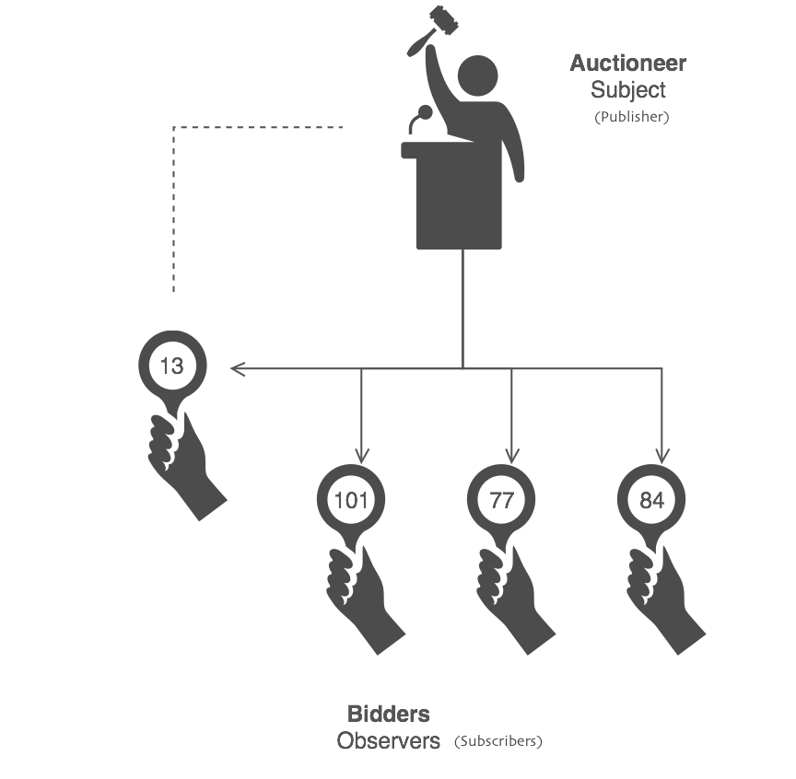
Observer Pattern Synchronization

Slide 92
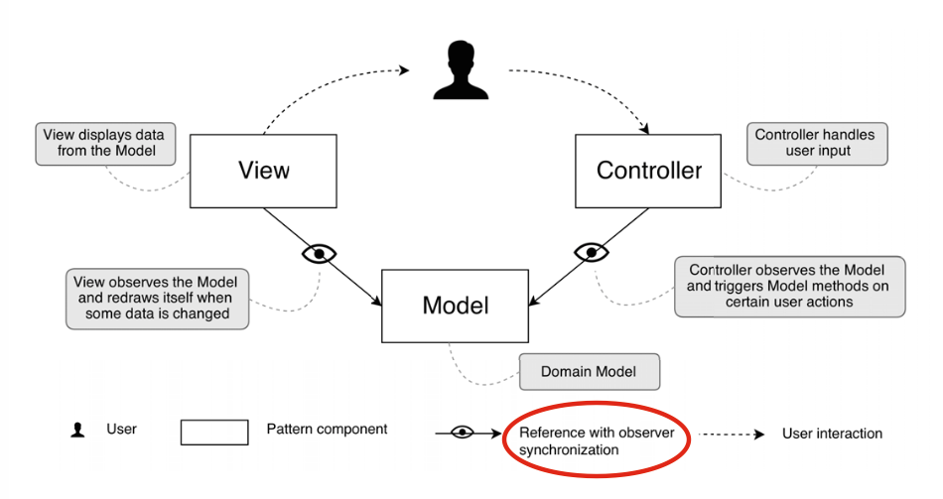
MVC – Model View Controller

Slide 93
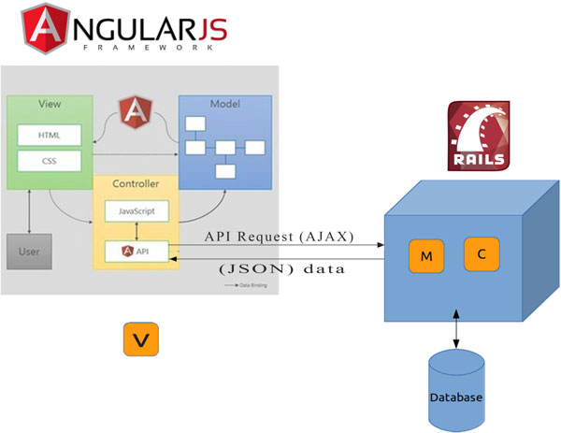
MVC – Model View Controller

Slide 94
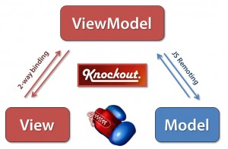
MVVM – Model View ViewModel

Slide 95
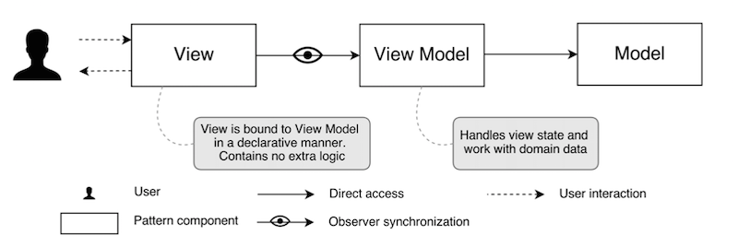
MVVM – Model View ViewModel

Slide 96
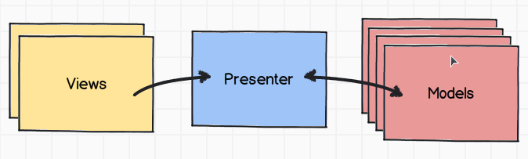
§ MVP – Model View Presenter

Slide 97
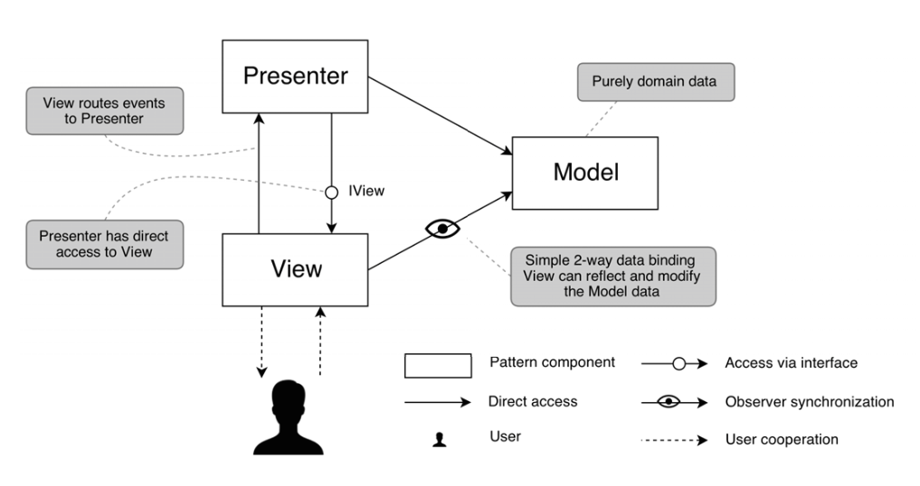
§ MVP – Model View Presenter

Slide 98
RWD
Responsive web design (RWD) is an approach to web design aimed at crafting sites to provide an optimal viewing experience—easy reading and navigation with a minimum of resizing, panning, and scrolling—across a wide range of devices (from desktop computer monitors to mobile phones).[

Slide 99
Why RWD
A site designed with RWD adapts the layout to the viewing environment by using
Fluid
proportion-based grids
flexible images
CSS3 media queries
an extension of the @media rule

Slide 100
Why RWD
The fluid grid concept calls for page element sizing to be in relative units like percentages, rather than absolute units like pixels or points.
Flexible images are also sized in relative units, so as to prevent them from displaying outside their containing element.
Media queries allow the page to use different CSS style rules based on characteristics of the device the site is being displayed on, most commonly the width of the browser.

Slide 101
User Interface
CSS user interface properties:
resize
outline-offset
resize: vertical or horizontal or both,
div { resize: vertical; overflow: auto; }
outline-offset: 15px; div.ex1 { margin: 20px; border: 1px solid black; outline: 4px solid red; outline-offset: 15px; } div.ex2 { margin: 10px; border: 1px solid black; outline: 5px dashed blue; outline-offset: 5px; });,

Slide 102
Implementing RWD
Viewport or screen size?
Viewport relates to the content area within the browser window, excluding the toolbars, tabs, and so on.
it relates to the area where a website actually displays.
Screen size refers to the physical display area of a device.
Beware that some browser resizer tools display the size, including browser elements such as the URL bar, tabs, and search boxes, and others don't.

Slide 103
Media query syntax
body {
background-color: grey;
}
@media screen and (max-width: 960px) {
body {
background-color: red;
}
}
@media screen and (max-width: 768px) {
body {
background-color: orange;
}
}

Slide 104
What can media queries test for?
width: The viewport width.
height: The viewport height.
device-width: The rendering surface's width (for our purposes, this is typically the screen width of a device).
device-height: The rendering surface's height (for our purposes, this is typically the screen height of a device).
orientation: This capability checks whether a device is portrait or landscape in orientation.
aspect-ratio: The ratio of width to height based upon the viewport width and height.
A 16:9 widescreen display can be written as aspect-ratio: 16/9.

Slide 105
Fluid Layout
#wrapper {
margin-right: auto;
margin-left: auto;
width: 96%; /* Holding outermost DIV */
}

Slide 106
CSS Box Sizing
The CSS box-sizing property allows us to include the padding and
border in an element's total width and height.
.div1 { width: 300px; height: 100px; border: 1px solid blue; box-sizing: border-box; } .div2 { width: 300px; height: 100px; padding: 50px; border: 1px solid red; box-sizing: border-box; }

Slide 107
View Port
The viewport is the user's visible area of a web page.
The viewport varies with the device, and will be smaller on a mobile phone than on a computer screen.
<meta name="viewport" content="width=device-width, initial-scale=1.0">
A <meta> viewport element gives the browser instructions on how to control the page's dimensions and scaling.
The width=device-width part sets the width of the page to follow the screen-width of the device (which will vary depending on the device).
The initial-scale=1.0 part sets the initial zoom level when the page is first loaded by the browser.

Slide 108
View Port
Size Content to The Viewport
Users are used to scroll websites vertically on both desktop and mobile devices - but not horizontally!
So, if the user is forced to scroll horizontally, or zoom out, to see the whole web page it results in a poor user experience.
Some additional rules to follow:
1. Do NOT use large fixed width elements - For example, if an image is displayed at a width wider than the viewport it can cause the viewport to scroll horizontally. Remember to adjust this content to fit within the width of the viewport.

Slide 109
View Port
2. Do NOT let the content rely on a particular viewport width to render well - Since screen dimensions and width in CSS pixels vary widely between devices, content should not rely on a particular viewport width to render well.
3. Use CSS media queries to apply different styling for small and large screens - Setting large absolute CSS widths for page elements will cause the element to be too wide for the viewport on a smaller device. Instead, consider using relative width values, such as width: 100%. Also, be careful of using large absolute positioning values. It may cause the element to fall outside the viewport on small devices.

Slide 110
What is a Grid-View?
Many web pages are based on a grid-view, which means that the page is divided into columns:
Using a grid-view is very helpful when designing web pages. It makes it easier to place elements on the page.
A responsive grid-view often has 12 columns, and has a total width of 100%, and will shrink and expand as you resize the browser window.

Slide 111
Using ems rather than pixels for typography
#content h1 span {
display: block;
line-height: 1.052631579em; /* 40 ÷ 38 */
color: #757474;
font-size: .550724638em; /* 38 ÷ 69 */
}

Slide 112
Fluid images
img {
max-width: 100%;
}

Slide 113
What is a Fluid Grid?
A fluid is a substance that continually deforms (flows) under an applied shear stress .
In adaptive grids, we define pixel-based dimensions. Hence we will have to adjust the widths and heights manually in certain device viewports.
Since fluid grids flow naturally within the dimensions of its parent container, limited adjustments will be needed for various screen sizes and devices.

Slide 114
Responsive Design and Twitter Bootstrap
Kathy E. Gill
@kegill

Slide 115

Introductions
Who are we?
What do you do?
What do you want to do?
What tools or areas of web design interest you most?
About the class ….

Slide 116

Design
What is it?

Slide 117
Concepts
Responsive Design
Frameworks
Open Source

Slide 118
Design is a process for developing solutions that effectively integrate task, context of use, and “user.”

Slide 119
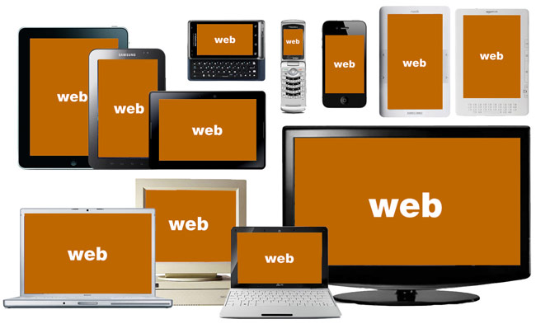
State of Today’s Web
Source: http://bradfrostweb.com/
Notes:
This is the challenge.
How do you design for all of this?
How do you manage the budget (staff, resources)?

Slide 120
51% of US mobile phones are smartphones

Slide 121
“Anyone who slaps a ‘This page is best viewed with browser X’ label on a web page appears to be yearning for the bad old days, before the web, when you had very little chance of reading a document written on another computer, another word processor, or another network.”
Tim Berners-Lee in Technology Review, July 1996

Slide 122
What is Responsive Web Design?
An approach to web design that provides an optimal viewing experience across a wide range of devices.
http://www.alistapart.com/articles/responsive-web-design/
Notes:
First introduced in 2009 by Ethan Marcotte who has also written a book with the same title.

Slide 123
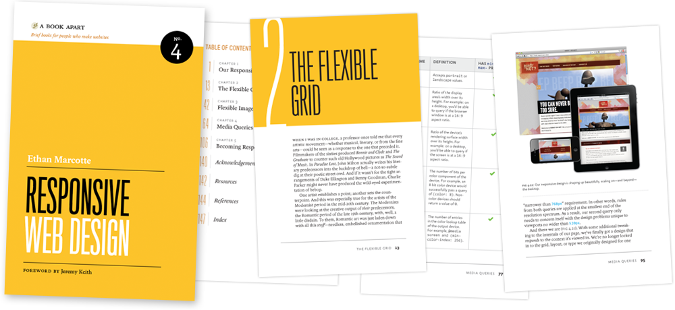
http://www.abookapart.com/products/responsive-web-design
Notes:
First introduced in 2009 by Ethan Marcotte who has also written a book with the same title.

Slide 124
Elements of RWD
Fluid Grid
Resizable Images
Media Queries
Notes:
First introduced in 2009 by Ethan Marcotte who has also written a book with the same title and which I also recommend.
I’ve spent the last two years learning about and really digging into responsive Web design and I’ve gotta say, It is the beginning of a new era in the Web.

Slide 125
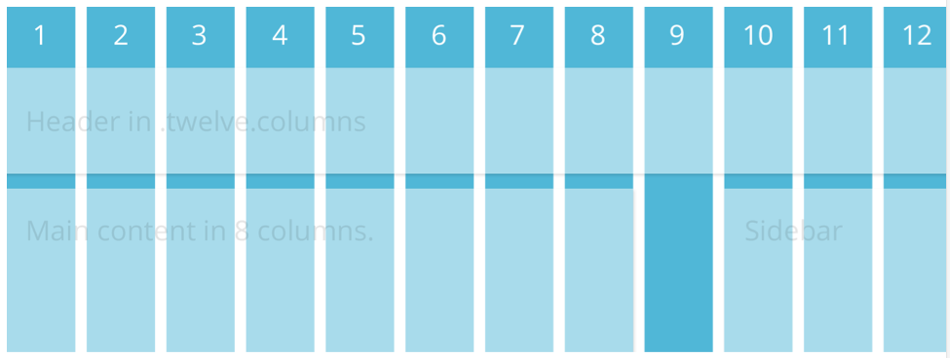
Grids

Slide 126
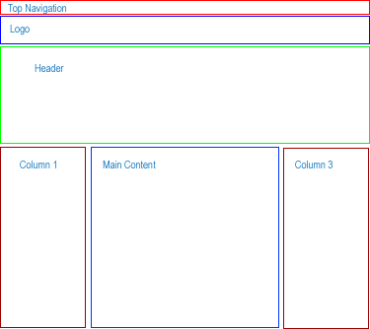
Grids /

Slide 127
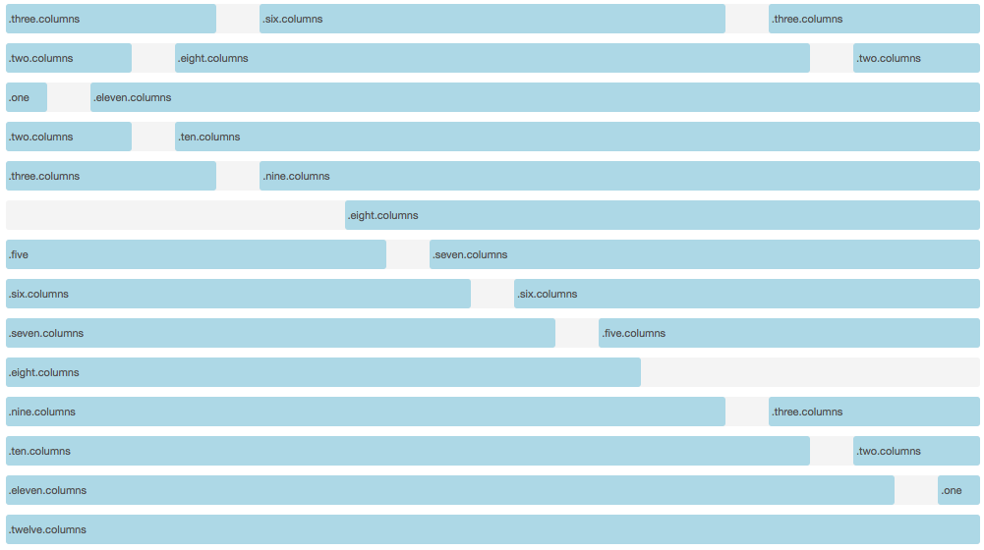
How do grid systems work?

Slide 128
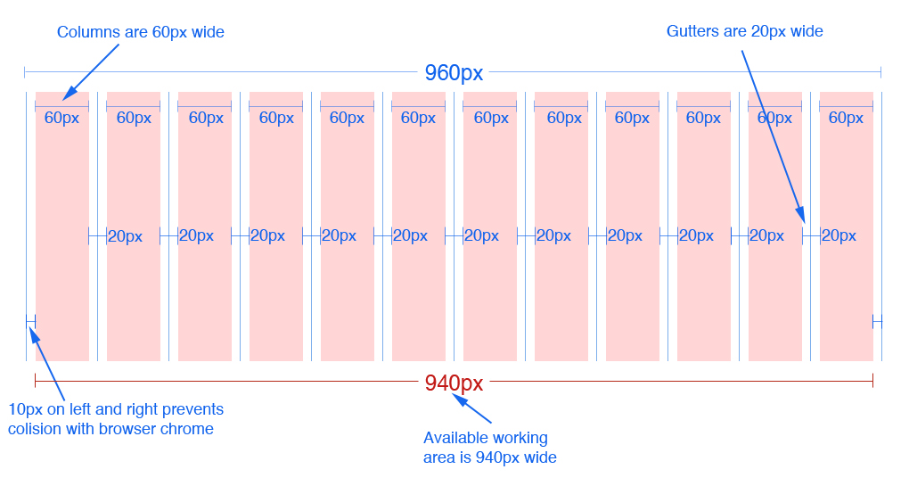
12 column version
12 column version
Source: 960.gs
Notes:
In the 16 column version each column is 40px wide. Everything else remains the same

Slide 129
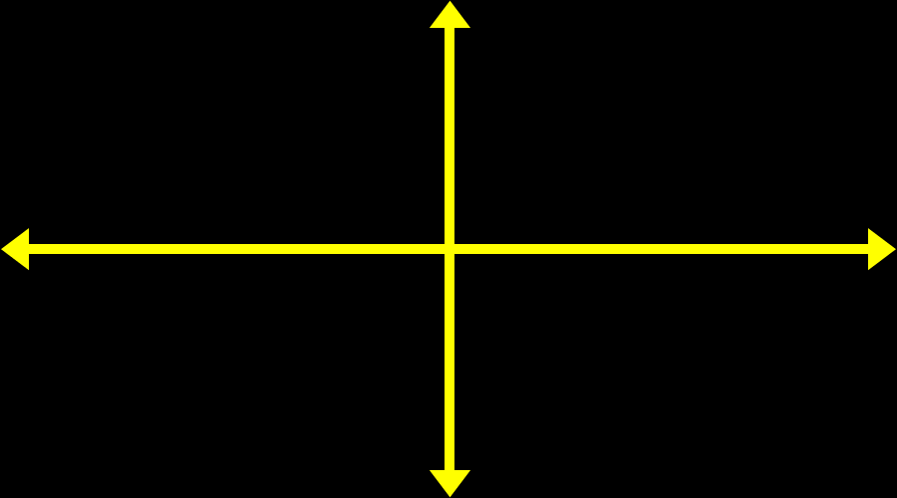
Resizable Images
img {
max-width: 100%;height: auto;}

Slide 130
Media Queries
A CSS3 module that renders web pages based on conditions such as screen resolution
Drafted in 2001 by the W3C
Became a recommended standard in June 2012
Source: Wikipedia.org
Notes:
First introduced in 2009 by Ethan Marcotte who has also written a book with the same title and which I also recommend.
I’ve spent the last two years learning about and really digging into responsive Web design and I’ve gotta say, It is the beginning of a new era in the Web.

Slide 131
Common Breakpoints
Label | Layout Width
Smartphones | 480px and below
Portrait Tables | 480px to 768px
Landscape Tablets | 768px to 940px
Default | 940px and up
Large Screens | 1210px and up

Slide 132
Advantages & Disadvantages
Advantages | Disadvantages
User Experience (UX) | User Experience/Load Time
Analytics | No linking
Sharing/Linking | SEO
SEO | Development
Development | Design
Maintenance
Source: http://www.seomoz.org/

Slide 133
Frameworks
Project requirements determine the framework
Fluid Grid System
Responsiveness a plus
Offer more than just a grid (pre-defined styles for typography, tables, buttons, navigation, forms elements, etc.)

Slide 134
Frameworks
Great documentation
Maintained regularly by the community or creator
Open Source (free)

Slide 135
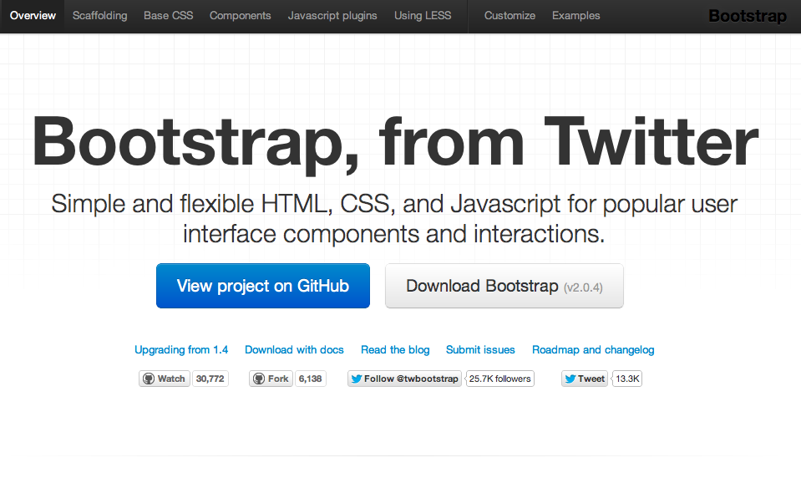

Slide 136
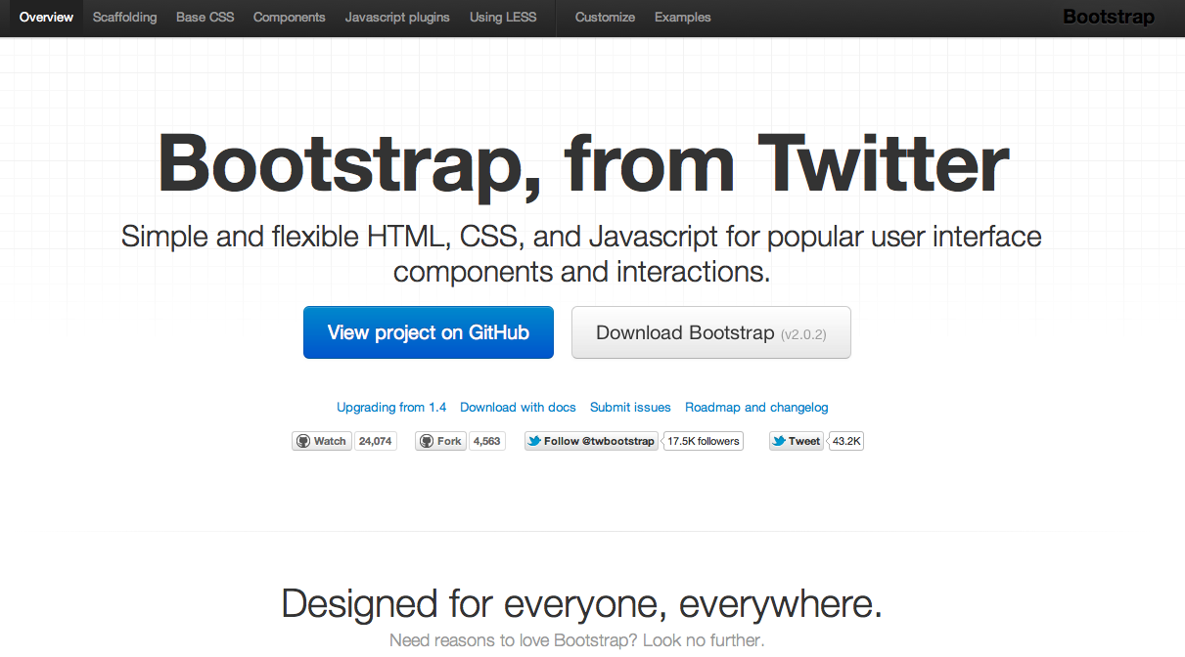
What
http://twitter.github.com/bootstrap/

Slide 137
Twitter Bootstrap
A freely available design framework for websites and web applications
Based upon HTML5, CSS and JavaScript
Supports all major browsers (even IE7!)
Released on GitHub in August 2011

Slide 138
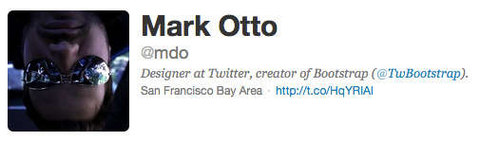
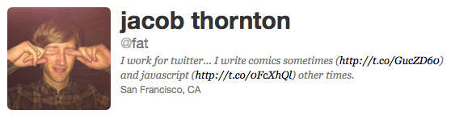
Created By

Slide 139
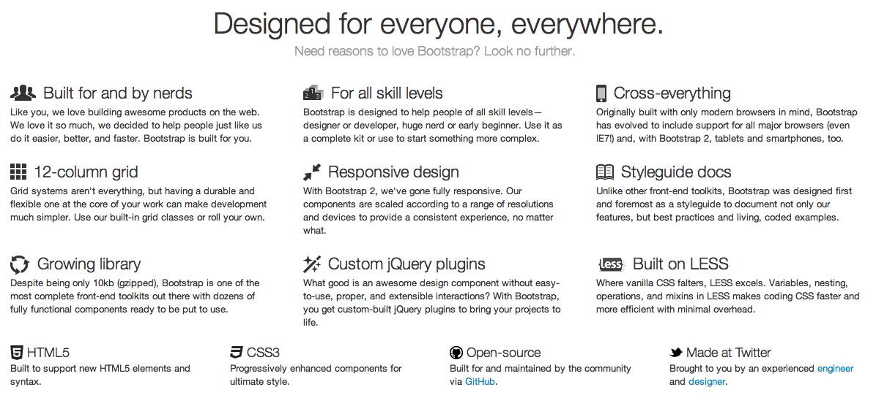
Why
Reason #1: Rich Features

Slide 140
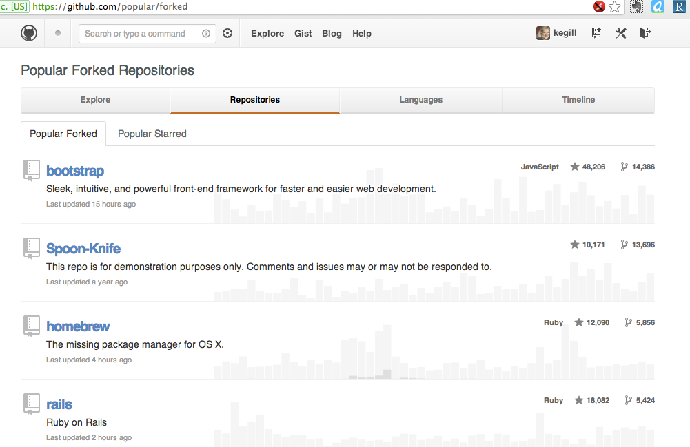
Why
Reason #2: Popularity

Slide 141



Why
Reason #3: Browser Support
Also MSIE and Opera

Slide 142

Why
Reason #4: Glyph Icon Set

Slide 143
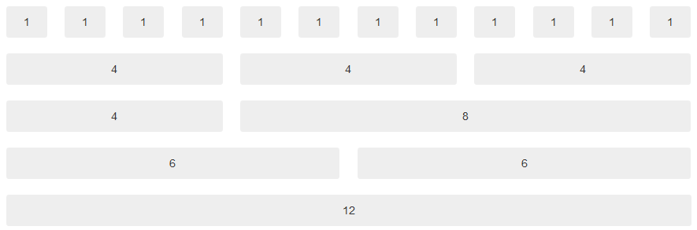
Why
Reason #5: Grid System
960 Grid System http://960.gs/
Blue Print CSS http://www.blueprintcss.org/
Golden Grid System http://goldengridsystem.com/
Notes:
Bootstrap is using a grid system base on 12 columns.
What is a grid system? A grid system is a way to create a solid foundation to build your project on.
If you want your web application to have a left navigation you could design your HTML using row number 3
If you do not want any navigation and you want your content to be as wide as possible then you could use row number 5
This grid design was popularized by 960 grid system http://960.gs and BluePrint http://www.blueprintcss.org

Slide 144

Why
Reason #6: Components
Buttons:
Tabs:
Breadcrumb:
Pagination:
Alerts:
Progress bar:
Notes:
Here is a list of some of the CSS component available. There are dozens of them available with bootstrap.

Slide 145
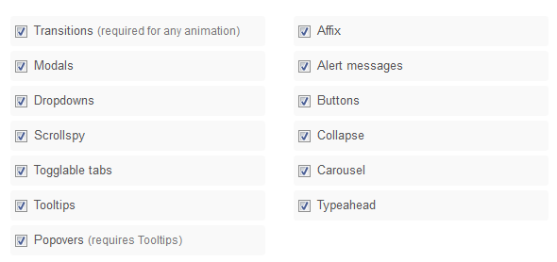
Why
Reason #7: Javascript/jQuery
Notes:
Bootstrap gives life to its UI by using Jquery plugins.

Slide 146
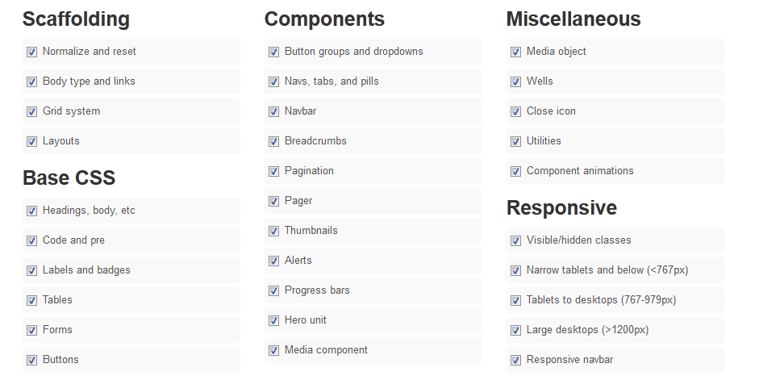
Why
Reason #8: Customization
Notes:
Bootstrap provides a web-based customizer that allow you to generate a CSS file based on your specific needs.

Slide 147
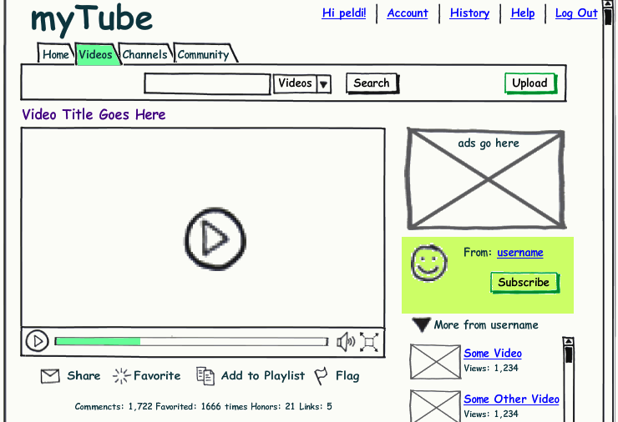
Why
Reason #9: Live Mock-Ups

Slide 148
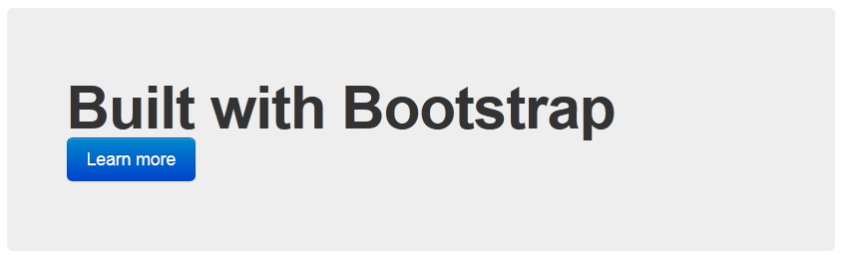

Slide 149

How
Download Bootstrap and inline text editor
Install text editor
Extract the bootstrap files in to your project folder
Download example html file and save it as index.html in the project folder

Slide 150
JSON The x in Ajax
Douglas Crockford
Yahoo! Inc.

Slide 151
YAHOO IS HIRING DEVELOPERS
Ajax, PHP, DHTML/XHTML, Javascript, CSS, Actionscript / Flash
Josie Aguada
JAGUADA@YAHOO-INC.COM

Slide 152
Data Interchange
The key idea in Ajax.
An alternative to page replacement.
Applications delivered as pages.
How should the data be delivered?

Slide 153
History of Data Formats
Ad Hoc
Database Model
Document Model
Programming Language Model

Slide 154
JSON
JavaScript Object Notation
Minimal
Textual
Subset of JavaScript

Slide 155
JSON
A Subset of ECMA-262 Third Edition.
Language Independent.
Text-based.
Light-weight.
Easy to parse.

Slide 156
JSON Is Not...
JSON is not a document format.
JSON is not a markup language.
JSON is not a general serialization format.
No cyclical/recurring structures.
No invisible structures.
No functions.

Slide 157
History
1999 ECMAScript Third Edition
2001 State Software, Inc.
2002 JSON.org
2005 Ajax
2006 RFC 4627

Slide 158

Languages
Chinese
English
French
German
Italian
Japanese
Korean

Slide 159
Languages
ActionScript
C / C++
C#
Cold Fusion
Delphi
E
Erlang
Java
Lisp
Perl
Objective-C
Objective CAML
PHP
Python
Rebol
Ruby
Scheme
Squeak

Slide 160
Object Quasi-Literals
JavaScript
Python
NewtonScript

Slide 161
Values
Strings
Numbers
Booleans
Objects
Arrays
null

Slide 162
Value

Slide 163
Strings
Sequence of 0 or more Unicode characters
No separate character type
A character is represented as a string with a length of 1
Wrapped in "double quotes"
Backslash escapement

Slide 164
String

Slide 165
Numbers
Integer
Real
Scientific
No octal or hex
No NaN or Infinity
Use null instead

Slide 166
Number

Slide 167
Booleans
true
false

Slide 168
null
A value that isn't anything

Slide 169
Object
Objects are unordered containers of key/value pairs
Objects are wrapped in { }
, separates key/value pairs
: separates keys and values
Keys are strings
Values are JSON values
struct, record, hashtable, object

Slide 170
Object

Slide 171
Object
{"name":"Jack B. Nimble","at large": true,"grade":"A","level":3, "format":{"type":"rect","width":1920, "height":1080,"interlace":false, "framerate":24}}

Slide 172
Object
{
"name": "Jack B. Nimble",
"at large": true,
"grade": "A",
"format": {
"type": "rect",
"width": 1920,
"height": 1080,
"interlace": false,
"framerate": 24
}
}

Slide 173
Array
Arrays are ordered sequences of values
Arrays are wrapped in []
, separates values
JSON does not talk about indexing.
An implementation can start array indexing at 0 or 1.

Slide 174
Array

Slide 175
Array
["Sunday", "Monday", "Tuesday", "Wednesday", "Thursday", "Friday", "Saturday"]
[
[0, -1, 0],
[1, 0, 0],
[0, 0, 1]
]

Slide 176
Arrays vs Objects
Use objects when the key names are arbitrary strings.
Use arrays when the key names are sequential integers.
Don't get confused by the term Associative Array.

Slide 177
MIME Media Type
application/json

Slide 178
Character Encoding
Strictly UNICODE.
Default: UTF-8.
UTF-16 and UTF-32 are allowed.

Slide 179
Versionless
JSON has no version number.
No revisions to the JSON grammar are anticipated.
JSON is very stable.

Slide 180
Rules
A JSON decoder must accept all well-formed JSON text.
A JSON decoder may also accept non-JSON text.
A JSON encoder must only produce well-formed JSON text.
Be conservative in what you do, be liberal in what you accept from others.

Slide 181
Supersets
YAML is a superset of JSON.
A YAML decoder is a JSON decoder.
JavaScript is a superset of JSON.
A JavaScript compiler is a JSON decoder.
New programming languages based on JSON.

Slide 182
JSON is the X in Ajax

Slide 183
JSON in Ajax
HTML Delivery.
JSON data is built into the page.
<html>...
<script>
var data = { ... JSONdata ... };
</script>...
</html>

Slide 184
JSON in Ajax
XMLHttpRequest
Obtain responseText
Parse the responseText
responseData = eval(
'(' + responseText + ')');
responseData =
responseText.parseJSON();

Slide 185
JSON in Ajax
Is it safe to use eval with XMLHttpRequest?
The JSON data comes from the same server that vended the page. eval of the data is no less secure than the original html.
If in doubt, use string.parseJSON instead of eval.

Slide 186
JSON in Ajax
Secret <iframe>
Request data using form.submit to the <iframe> target.
The server sends the JSON text embedded in a script in a document.
<html><head><script>
document.domain = 'penzance.com';
parent.deliver({ ... JSONtext ... });
</script></head></html>
The function deliver is passed the value.

Slide 187
JSON in Ajax
Dynamic script tag hack.
Create a script node. The src url makes the request.
The server sends the JSON text embedded in a script.
deliver({ ... JSONtext ... });
The function deliver is passed the value.
The dynamic script tag hack is insecure.

Slide 188
JSONRequest
A new facility.
Two way data interchange between any page and any server.
Exempt from the Same Origin Policy.
Campaign to make a standard feature of all browsers.

Slide 189
JSONRequest
function done(requestNr, value, exception) {
...
}
var request =
JSONRequest.post(url, data, done);
var request =
JSONRequest.get(url, done);
No messing with headers.
No cookies.
No implied authentication.

Slide 190
JSONRequest
Requests are transmitted in order.
Requests can have timeouts.
Requests can be cancelled.
Connections are in addition to the browser's ordinary two connections per host.
Support for asynchronous, full duplex connections.

Slide 191
JSONRequest
Tell your favorite browser maker
I want JSONRequest!
http://www.JSON.org/JSONRequest.html

Slide 192
ECMAScript Fourth Ed.
New Methods:
Object.prototype.toJSONString
String.prototype.parseJSON
Available now: JSON.org/json.js

Slide 193
supplant
var template = '<table border="{border}">' +
'<tr><th>Last</th><td>{last}</td></tr>' +
'<tr><th>First</th><td>{first}</td></tr>' +
'</table>';
var data = {
"first": "Carl",
"last": "Hollywood",
"border": 2
};
mydiv.innerHTML = template.supplant(data);

Slide 194
supplant
String.prototype.supplant = function (o) {
return this.replace(/{([^{}]*)}/g,
function (a, b) {
var r = o[b];
return typeof r === 'string' ?
r : a;
}
);
};

Slide 195
JSONT
var rules = {
self:
'<svg><{closed} stroke="{color}" points="{points}" /></svg>',
closed: function (x) {return x ? 'polygon' : 'polyline';},
'points[*][*]': '{$} '
};
var data = {
"color": "blue",
"closed": true,
"points": [[10,10], [20,10], [20,20], [10,20]]
};
jsonT(data, rules)
<svg><polygon stroke="blue"
points="10 10 20 10 20 20 10 20 " /></svg>

Slide 196
http://goessner.net/articles/jsont/
function jsonT(self, rules) {
var T = {
output: false,
init: function () {
for (var rule in rules) if (rule.substr(0,4) != "self") rules["self." + rule] = rules[rule];
return this;
},
apply: function(expr) {
var trf = function (s) {
return s.replace(/{([A-Za-z0-9_\$\.\[\]\'@\(\)]+)}/g, function ($0, $1){
return T.processArg($1, expr);
})
}, x = expr.replace(/\[[0-9]+\]/g, "[*]"), res;
if (x in rules) {
if (typeof(rules[x]) == "string") res = trf(rules[x]);
else if (typeof(rules[x]) == "function") res = trf(rules[x](eval(expr)).toString());
} else res = T.eval(expr);
return res;
},
processArg: function (arg, parentExpr) {
var expand = function (a, e) {
return (e = a.replace(/^\$/,e)).substr(0, 4) != "self" ? ("self." + e) : e;
}, res = "";
T.output = true;
if (arg.charAt(0) == "@") res = eval(arg.replace(/@([A-za-z0-9_]+)\(([A-Za-z0-9_\$\.\[\]\']+)\)/, function($0, $1, $2){
return "rules['self." + $1 + "'](" + expand($2,parentExpr) + ")";
}));
else if (arg != "$") res = T.apply(expand(arg, parentExpr));
else res = T.eval(parentExpr);
T.output = false;
return res;
},
eval: function (expr) {
var v = eval(expr), res = "";
if (typeof(v) != "undefined") {
if (v instanceof Array) {
for (var i = 0; i < v.length; i++) if (typeof(v[i]) != "undefined") res += T.apply(expr + "[" + i + "]");
} else if (typeof(v) == "object") {
for (var m in v) if (typeof(v[m]) != "undefined") res += T.apply(expr+"."+m);
} else if (T.output) res += v;
}
return res;
}
};
return T.init().apply("self");
}

Slide 197
Some features that make it well-suited for data transfer
It's simultaneously human- and machine-readable format;
It has support for Unicode, allowing almost any information in any human language to be communicated;
The self-documenting format that describes structure and field names as well as specific values;
The strict syntax and parsing requirements that allow the necessary parsing algorithms to remain simple, efficient, and consistent;
The ability to represent the most general computer science data structures: records, lists and trees.

Slide 198
JSON Looks Like Data
JSON's simple values are the same as used in programming languages.
No restructuring is required: JSON's structures look like conventional programming language structures.
JSON's object is record, struct, object, dictionary, hash, associate array...
JSON's array is array, vector, sequence, list...

Slide 199
Arguments against JSON
JSON Doesn't Have Namespaces.
JSON Has No Validator.
JSON Is Not Extensible.
JSON Is Not XML.

Slide 200
JSON Doesn't Have Namespaces
Every object is a namespace. Its set of keys is independent of all other objects, even exclusive of nesting.
JSON uses context to avoid ambiguity, just as programming languages do.

Slide 201
Namespace
http://www.w3c.org/TR/REC-xml-names/
In this example, there are three occurrences of the name title within the markup, and the name alone clearly provides insufficient information to allow correct processing by a software module.
<section>
<title>Book-Signing Event</title>
<signing>
<author title="Mr" name="Vikram Seth" />
<book title="A Suitable Boy" price="$22.95" />
</signing>
<signing>
<author title="Dr" name="Oliver Sacks" />
<book title="The Island of the Color-Blind"
price="$12.95" />
</signing>
</section>

Slide 202
Namespace
{"section":
"title": "Book-Signing Event",
"signing": [
{
"author": { "title": "Mr", "name": "Vikram Seth" },
"book": { "title": "A Suitable Boy",
"price": "$22.95" }
}, {
"author": { "title": "Dr", "name": "Oliver Sacks" },
"book": { "title": "The Island of the Color-Blind",
"price": "$12.95" }
}
]
}}
section.title
section.signing[0].author.title
section.signing[1].book.title

Slide 203
JSON Has No Validator
Being well-formed and valid is not the same as being correct and relevant.
Ultimately, every application is responsible for validating its inputs. This cannot be delegated.
A YAML validator can be used.

Slide 204
JSON is Not Extensible
It does not need to be.
It can represent any non-recurrent data structure as is.
JSON is flexible. New fields can be added to existing structures without obsoleting existing programs.

Slide 205
JSON Is Not XML
objects
arrays
strings
numbers
booleans
null
element
attribute
attribute string
content
<![CDATA[ ]]>
entities
declarations
schema
stylesheets
comments
version
namespace

Slide 206
Data Interchange
JSON is a simple, common representation of data.
Communication between servers and browser clients.
Communication between peers.
Language independent data interchange.

Slide 207
Why the Name?
XML is not a good data interchange format, but it is a document standard.
Having a standard to refer to eliminates a lot of squabbling.

Slide 208
Going Meta
By adding one level of meta-encoding, JSON can be made to do the things that JSON can't do.
Recurrent and recursive structures.
Values beyond the ordinary base values.

Slide 209
Going Meta
Simply replace the troublesome structures and values with an object which describes them.
{
"$META$": meta-type,
"value": meta-value
}

Slide 210
Going Meta
Possible meta-types:
"label" | Label a structure for reuse.
"ref" | Reuse a structure.
"class" | Associate a class with a structure.
"type" | Associate a special type, such as Date, with a structure.

Slide 211
Browser Innovation
During the Browser War, innovation was driven by the browser makers.
In the Ajax Age, innovation is being driven by application developers.
The browser makers are falling behind.

Slide 212
The Mashup Security Problem
Mashups are an interesting new way to build applications.
Mashups do not work when any of the modules or widgets contains information that is private or represents a connection which is private.

Slide 213
The Mashup Security Problem
JavaScript and the DOM provide completely inadequate levels of security.
Mashups require a security model that provides cooperation under mutual suspicion.

Slide 214
The Mashup Security Solution
<module id="NAME" href="URL" style="STYLE" />
A module is like a restricted iframe. The parent script is not allowed access to the module's window object. The module's script is not allowed access to the parent's window object.

Slide 215
The Mashup Security Solution
<module id="NAME" href="URL" style="STYLE" />
The module node presents a send method which allows for sending a JSON string to the module script.
The module node can accept a receive method which allows for receiving a JSON string from the module script.

Slide 216
The Mashup Security Solution
<module id="NAME" href="URL" style="STYLE" />
Inside the module, there is a global send function which allows for sending a JSON string to the outer document's script.
Inside the module, you can define a receive method which allows for receiving a JSON string from the outer document's script.

Slide 217
The Mashup Security Solution
<module id="NAME" href="URL" style="STYLE" />

Slide 218
The Mashup Security Solution
<module id="NAME" href="URL" style="STYLE" />
Communiciation is permitted only through cooperating send and receive functions.
The module is exempt from the Same Origin Policy.

Slide 219
The Mashup Security Solution
<module id="NAME" href="URL" style="STYLE" />
Ask your favorite browser maker for the <module> tag.

Slide 220
www.JSON.org

Slide 221
Introduction to Jquery & Syntax

Slide 222
Objectives
At the end of this module you will understand
What is jQuery?
jQuery Features
How jQuery Works
Downloading jQuery Library
Using jQuery Library
Basic jQuery Example

Slide 223
What is jQuery?
jQuery is an open-source library of JavaScript functions
jQuery project started in 2006 by John Resig
jQuery helps you to easily & quickly write clean JavaScript
The jQuery library contains many common functions & plug-ins that you can extend immediately. For example:
Applying styles on HTML DOM elements on-the-fly
Use AJAX out-of-the-box
Add date picker, auto-complete, progress bar, menu tabs to your forms
Make animations almost as good as Flash can

Slide 224
JQuery
jQuery is a fast, lightweight JavaScript library that is CSS3 compliant and supports many browsers.
The jQuery framework is extensible and very nicely handles DOM manipulations, CSS, AJAX, Events and Animations.
JavaScript is a language whereas jQuery is a library written using JavaScript.

Slide 225
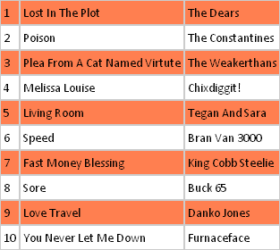
Why jQuery?
Consider that we have to apply zebra-stripes on a table with many rows
This can be achieved by either using CSS or JavaScript
Using CSS has an immediate fall-out – Row Consistency
A typical JavaScript function will require about a few dozen lines of code and could look something like this:

Slide 226
Zebra-striping with JavaScript
var stripe = function() {
var tables = document.getElementsByTagName("table");
for(var x=0;x!=tables.length;x++){
var table = tables[x];
if (! table) { return; }
var tbodies = table.getElementsByTagName("tbody");
for (var h = 0; h < tbodies.length; h++) {
var even = true;
var trs = tbodies[h].getElementsByTagName("tr");
for (var i = 0; i < trs.length; i++) {
this.className += " ruled"; return false
if(even) trs[i].className += " even";
even = !even;
}
}
}
}
window.onload = stripe;

Slide 227
Zebra-striping with jQuery
$("tr:nth-child(even)").css('background-color','coral');

Slide 228
What does jQuery do?
Crunches JavaScript
reduces the number of lines of JavaScript you would have to write, call it shortcut JavaScript
Manipulate HTML
allows you to select & manipulate HTML, popularly used to manipulate <form> elements
Manipulate CSS
allows you to apply, remove or change CSS properties applied on HTML elements, on-the-fly
Out-of-the-box widgets
includes many commonly needed widgets. For example, calendar popups, accordion, tab panels, etc
Animation
apply animated effects like show, hide, slide on HTML elements. Also includes some very cool animation effects on images.

Slide 229
Downloading jQuery Library
Download the latest release of the library from jQuery.com
2 versions are available – minified & uncompressed
Alternatives to downloading:
Google CDN:
<head>
<script type="text/javascript" src="http://ajax.googleapis.com/ajax/libs/jquery/1.4.2/jquery.min.js"></script>
</head>
Microsoft CDN:
<head>
<script type="text/javascript" src="http://ajax.microsoft.com/ajax/jquery/jquery-1.4.2.min.js"></script>
</head>
Notes:
Content Delivery Network (CDN)

Slide 230
Basic jQuery Usage Example
<html>
<head>
<script type="text/javascript" src="myJsPath/jquery.js"></script>
<script type="text/javascript">
$(document).ready(function(){
$("button").click(function(){
$("p").hide();
});
});
</script>
</head>
<body>
<h2>This is a heading</h2>
<p>This is a paragraph.</p>
<p>This is another paragraph.</p>
<button>Click me</button>
</body>
</html>
Add the jQuery library file in
the head section

Slide 231
How does jQuery work?
jQuery works first by “Selecting” the HTML element(s) and then applying your “Action” on it
To select and apply action, use the jQuery object
The jQuery object can also be called using $
Example:
// Select all elements of class: "someClass" and
// apply a red border to all of them
jQuery(".someClass").css("border", "1px solid red");
// Exactly the same as above, but using $
$(".someClass").css("border", "1px solid red");
Notes:
In JavaScript, a declared function is by default a class and can be instantiated using the new operator
$ is the identifier name for the jQuery object

Slide 232
jQuery Syntax - $() Factory
All types of selectors in jQuery start with $()
The syntax is $(selector).action()
The $ sign defines jQuery
A selector to “query or find” HTML elements
A jQuery action() to perform on the HTML elements
Examples:
$(this).hide → hides current element
$(“p”).hide → hides all paragraphs
$(“p.test”).hide → hides all paragraphs with class=“test”
$(“#test”).hide → hides the element with id=“test”

Slide 233
jQuery Chaining
To apply more than one action to a set of “selected” elements, you can chain it
Example:
$('img').clone().appendTo('#previews').addClass('beenCloned');
Note that while chaining, each action is performed only after the previous has completed

Slide 234
The Document Ready Function
$(document).ready(function(){
// jquery function go here…
});
This method of writing function, prevents the jQuery function from running before the document is finished loading (is ready)
Note: It is not mandatory to write jQuery statements within this construct
Notes:
Most jQuery functions that you want to run after the document (page) is loaded, use this construct.
Examples of actions that can fail if functions are run before the document is fully loaded:
Trying to hide an element that doesn't exist
Trying to get the size of an image that is not loaded

Slide 235
Ready vs Load
$( document ).ready(function() { console.log( "document loaded" ); }); $( window ).load(function() { console.log( "window loaded" ); });

Slide 236
$(document).ready() function
If you want an event to work on your page, you should call it inside the $(document).ready() function.
This is to prevent any jQuery code from running before the document is finished loading (is ready).
Everything inside it will load as soon as the DOM is loaded and before the page contents are loaded.
The $(document).ready() function has some benefit for its own way to make its events to work.
First no need for "behavioral" markup tag in the HTML.
$(document).ready() helps your events to get load or fire before the window loads.
Anything that you write inside its brackets is ready as soon as the DOM is registered by the browser.

Slide 237
How to write jQuery functions
Simple function:
$(document).ready(function(){
$(“p”).hide();
}); // end document.ready
Nested function:
$(document).ready(function(){
$(“button”).click(function(){
var num1 = 10;
var num2 = 5;
var numSum = num1 + num2;
alert(“The sum is ” + numSum);
}); // end click
}); // end document.ready

Slide 238
jQuery
jQuery Syntax
The jQuery syntax is made for selecting HTML elements and perform some action on the element(s).
Syntax $(selector).action()
A dollar sign to define jQuery
A (selector) to "query (or find)" HTML elements
A jQuery action() to be performed on the element(s)

Slide 239
jQuery Selectors

Slide 240
Objective
At the end of this sub module we will understand
Element Selectors
CSS Selectors
Attribute Selectors
Advanced Selectors

Slide 241
jQuery Selectors
In HTML DOM, selectors allow you to manipulate DOM elements as a group or as a single node
jQuery selectors allow you to select HTML elements (or groups of elements) by element name, attribute name or by content
Types of jQuery selectors:
Element Selectors
CSS Selectors
Attribute Selectors

Slide 242
jQuery Element Selectors
Element Selectors
jQuery uses the HTML tags to select HTML elements
Example:
$(“p”) → selects all <p> elements
$(“a”) → selects all <a> elements
$(“ul”) → selects al <ul> elements
$(“*”) → selects all elements within the document
$(“img, span”) → selects <img> and <span> elements

Slide 243
jQuery CSS Selectors
CSS Selectors
jQuery uses CSS IDs & classnames to select elements
A CSS ID is preceded with a ‘#’ & a classname with a ‘.’
Examples:
$(“#intro”) → selects the first element with id=“intro”
$(“p.intro”) → selects all <p> elements with class=“intro”
$(“a#myId.myClass”) → selects <a> with id=“myId” & class=“myClass”
$("p a.specialClass") → selects <a> with class=“specialClass” declared within <p> elements

Slide 244
jQuery Attribute Selectors
Attribute Selectors
jQuery uses XPath expressions to select elements with given attributes
To select, put the attribute with in [ ]
Examples:
$(“[href]”) → selects all elements with href attributes
$(“input[type=text]”) → selects all <input> elements with a type of text
Notes:
Attributes are parameters to HTML elements
Example: in <input type=“text”>, ‘type’ is the attribute and ‘text’ is its value
Example: in <a href=“http://google.com” target=“_blank”>, target is the attribute and _blank is its value

Slide 245
jQuery Advanced Selectors
jQuery advanced selector uses the next generation of CSS supported by Mozilla Firefox, IE 7, Chrome, Safari, etc
Examples:
$('*') → Selects all elements in the document
$(this) → Selects the current element
$("p > *") → Selects all elements that are children of <p> element
$("li:not(.myclass)") →Selects all elements matched by <li> that do not have class="myclass"
$("li > ul") → Selects all elements matched by <ul> that are children of an element matched by <li>
$("code, em, strong") → Selects all elements matched by <code> or <em> or <strong>
$("p:empty") → Selects all elements matched by <p> that have no children
$(":radio") → Selects all radio buttons in the form
$(":checked") → Selects all checked boxes in the form
$("[href!=‘#’]") → Selects all elements with href value NOT equal to “#”
$("[href^=‘http://’]") → Selects all elements with href value that starts with ‘http://’
$("[href$=‘.pdf’]") → Selects all elements with href value that ends with ‘.pdf’

Slide 246
jQuery Advanced Selectors
$("li:even") → Selects all elements matched by <li> that have an even index value
$("tr:odd") → Selects all elements matched by <tr> that have an odd index value
$("li:first") → Selects the first <li> element
$("li:last") → Selects the last <li> element
$("li:eq(2)") → Selects the third <li> element. Index starts at 0
$("li:lt(2)") → Selects all elements matched by <li> element before the third one; in other words, the first two <li> elements
$("li:gt(1)") → Selects all elements matched by <li> after the second one
$("li:first-child") → Selects all elements matched by <li> that are the first child of their parent
$("li:last-child") → Selects all elements matched by <li> that are the last child of their parent
$(":parent") → Selects all elements that are the parent of another element, including text
$("li:contains(second)") → Selects all elements matched by <li> that contain the text second
$("li:visible") → Selects all elements matched by <li> that are visible
$("li:hidden") → Selects all elements matched by <li> that are hidden
* The above examples are not limited to <li> & also apply to other elements like <p>, <img>, etc

Slide 247
jQuery Selector Usage
<html>
<head>
<title>jQuery - Selectors</title>
<script type="text/javascript" src="jsLib/jquery-1.4.2.min.js"></script>
</script>
</head>
<body>
<p id="intro">This is just a test of JQuery.</p>
<ol>
<li>Bangalore</li>
<li>Hyderabad</li>
<li>Kolkata</li>
<li>Chennai</li>
<li>Pune</li>
<li>Bhubaneswar</li>
</ol>
<p>This is how it is defined </p>

Slide 248
jQuery Selector Usage (cont'd)
<script type="text/javascript">
$(document).ready(function(){
$("p").css("background-color", "#ff9");
$("a").css("background-color","#f00");
$("p#intro").css("border","3px dashed #00f");
$("li:first").css("background-color","#66f");
$("li:contains(jQ)").css("background-color","#0f0");
});
</body></html>

Slide 249
Attributes
$( "a" ).attr( "href", "allMyHrefsAreTheSameNow.html" );
$( "a" ).attr({
title: "all titles are the same too!",
href: "somethingNew.html"
});

Slide 250
Pseudo-Selectors
// Select all input-like elements in a form (more on this below).
$( "#myForm :input" );
$( "div:visible" );
// All except the first three divs.
$( "div:gt(2)" );
// All currently animated divs.
$( "div:animated" );

Slide 251
Refining & Filtering Selections
// Refining selections.
$( "div.foo" ).has( "p" ); // div.foo elements that contain <p> tags
$( "h1" ).not( ".bar" ); // h1 elements that don't have a class of bar
$( "ul li" ).filter( ".current" ); // unordered list items with class of current
$( "ul li" ).first(); // just the first unordered list item
$( "ul li" ).eq( 5 );

Slide 252
Selecting Form Elements
$( "form :button" );
$( "form :checkbox" );
$( "form :checked" );
$( "form :disabled" );
$( "form :enabled" );
$( "form :file" );
$( "form :image" );
$( "form input[name='gender']:radio" );

Slide 253
Working with Selections
// The .html() method used as a setter:
$( "h1" ).html( "hello world" );
// The .html() method used as a getter:
$( "h1" ).html();
// Attempting to call a jQuery method after calling a getter.
// This will NOT work:
$( "h1" ).html().addClass( "test" );
$( "#content" ).find( "h3" ).eq( 2 ).html( "new text for the third h3!" );

Slide 254
Manipulating Elements
.html() – Get or set the HTML contents.
.text() – Get or set the text contents; HTML will be stripped.
.attr() – Get or set the value of the provided attribute.
.width() – Get or set the width in pixels of the first element in the selection as an integer.
.height() – Get or set the height in pixels of the first element in the selection as an integer.
.position() – Get an object with position information for the first element in the selection, relative to its first positioned ancestor. This is a getter only.
.val() – Get or set the value of form elements.

Slide 255
Moving, Copying, and Removing Elements
// Make the first list item the last list item:
var li = $( "#myList li:first" ).appendTo( "#myList" );
// Another approach to the same problem:
$( "#myList" ).append( $( "#myList li:first" ) );
// Making a copy of an element.
// Copy the first list item to the end of the list:
$( "#myList li:first" ).clone().appendTo( "#myList" );

Slide 256
Moving, Copying, and Removing Elements
There are two ways to remove elements from the page: .remove() and .detach(). Use .remove() when you want to permanently remove the selection from the page.
Use .detach() if you need the data and events to persist. Like .remove(), it returns the selection, but it also maintains the data and events associated with the selection, so you can restore the selection to the page at a later time.

Slide 257
Creating New Elements
// Creating new elements from an HTML string.
$( "<p>This is a new paragraph</p>" );
$( "<li class=\"new\">new list item</li>" );
// Creating a new element with an attribute object.
$( "<a/>", {
html: "This is a <strong>new</strong> link",
"class": "new",
href: "foo.html"
});

Slide 258
Creating New Elements
// Getting a new element on to the page.
var myNewElement = $( "<p>New element</p>" );
myNewElement.appendTo( "#content" );
myNewElement.insertAfter( "ul:last" ); // This will remove the p from #content!
$( "ul" ).last().after( myNewElement.clone() ); // Clone the p so now we have two.

Slide 259
Creating New Elements
// Creating and adding an element to the page at the same time.
$( "ul" ).append( "<li>list item</li>" );
var myItems = [];
var myList = $( "#myList" );
for ( var i = 0; i < 100; i++ ) {
myItems.push( "<li>item " + i + "</li>" );
}
myList.append( myItems.join( "" ) );

Slide 260
Manipulating Attributes
// Manipulating a single attribute.
$( "#myDiv a:first" ).attr( "href", "newDestination.html" );
// Manipulating multiple attributes.
$( "#myDiv a:first" ).attr({
href: "newDestination.html",
rel: "nofollow"
});

Slide 261
Manipulating Attributes
// Using a function to determine an attribute's new value.
$( "#myDiv a:first" ).attr({
rel: "nofollow",
href: function( idx, href ) {
return "/new/" + href;
}
});
$( "#myDiv a:first" ).attr( "href", function( idx, href ) {
return "/new/" + href;
});

Slide 262
Traversing
<div class="grandparent">
<div class="parent">
<div class="child">
<span class="subchild"></span>
</div>
</div>
<div class="surrogateParent1"></div>
<div class="surrogateParent2"></div>
</div>

Slide 263
Traversing
// Selecting an element's direct parent:
// returns [ div.child ]
$( "span.subchild" ).parent();
// Selecting all the parents of an element that match a given selector:
// returns [ div.parent ]
$( "span.subchild" ).parents( "div.parent" );
// returns [ div.child, div.parent, div.grandparent ]
$( "span.subchild" ).parents();

Slide 264
Traversing
// Selecting all the parents of an element up to, but *not including* the selector:
// returns [ div.child, div.parent ]
$( "span.subchild" ).parentsUntil( "div.grandparent" );
// Selecting the closest parent, note that only one parent will be selected and that the initial element itself is included in the search:
// returns [ div.child ]
$( "span.subchild" ).closest( "div" );
// returns [ div.child ] as the selector is also included in the search:
$( "div.child" ).closest( "div" );

Slide 265
Traversing
// Selecting an element's direct children:
// returns [ div.parent, div.surrogateParent1, div.surrogateParent2 ]
$( "div.grandparent" ).children( "div" );

Slide 266
Traversing
$( "div.parent" ).next();
// Selecting a prev sibling of the selectors:
// returns [] as No sibling exists before div.parent
$( "div.parent" ).prev();
// Selecting all the next siblings of the selector:
// returns [ div.surrogateParent1, div.surrogateParent2 ]
$( "div.parent" ).nextAll();

Slide 267
Traversing
// returns [ div.surrogateParent1 ]
$( "div.parent" ).nextAll().first();
// returns [ div.surrogateParent2 ]
$( "div.parent" ).nextAll().last();
// Selecting all the previous siblings of the selector:
// returns [ div.surrogateParent1, div.parent ]
$( "div.surrogateParent2" ).prevAll();
// returns [ div.surrogateParent1 ]
$( "div.surrogateParent2" ).prevAll().first();

Slide 268
CSS, Styling, & Dimensions
// Getting CSS properties.
$( "h1" ).css( "fontSize" ); // Returns a string such as "19px".
$( "h1" ).css( "font-size" ); // Also works.
// Setting CSS properties.
$( "h1" ).css( "fontSize", "100px" ); // Setting an individual property.
// Setting multiple properties.
$( "h1" ).css({
fontSize: "100px",
color: "red"
});

Slide 269
Using CSS Classes for Styling
h1.addClass( "big" );
h1.removeClass( "big" );
h1.toggleClass( "big" );
if ( h1.hasClass( "big" ) ) {
...
}

Slide 270
Dimensions
// Working with classes.
var h1 = $( "h1" );
// Basic dimensions methods.
// Sets the width of all <h1> elements.
$( "h1" ).width( "50px" );
// Gets the width of the first <h1> element.
$( "h1" ).width();

Slide 271
Dimensions
// Sets the height of all <h1> elements.
$( "h1" ).height( "50px" );
// Gets the height of the first <h1> element.
$( "h1" ).height();
// Returns an object containing position information for
// the first <h1> relative to its "offset (positioned) parent".
$( "h1" ).position();

Slide 272
Utility Methods
// Returns "lots of extra whitespace"
$.trim( " lots of extra whitespace " );
$.each([ "foo", "bar", "baz" ], function( idx, val ) {
console.log( "element " + idx + " is " + val );
});
$.each({ foo: "bar", baz: "bim" }, function( k, v ) {
console.log( k + " : " + v );
});

Slide 273
Utility Methods
var myArray = [ 1, 2, 3, 5 ];
if ( $.inArray( 4, myArray ) !== -1 ) {
console.log( "found it!" );
}

Slide 274
Utility Methods
var firstObject = { foo: "bar", a: "b" };
var secondObject = { foo: "baz" };
var newObject = $.extend( firstObject, secondObject );
console.log( firstObject.foo ); // "baz"
console.log( newObject.foo ); // "baz"

Slide 275
Iterating over jQuery and non-jQuery Objects
var sum = 0;
var arr = [ 1, 2, 3, 4, 5 ];
$.each( arr, function( index, value ){
sum += value;
});
console.log( sum ); //

Slide 276
Iterating over jQuery and non-jQuery Objects
<ul>
<li><a href="#">Link 1</a></li>
<li><a href="#">Link 2</a></li>
<li><a href="#">Link 3</a></li>
</ul>

Slide 277
Iterating over jQuery and non-jQuery Objects
$( "li" ).each( function( index, element ){
console.log( $( this ).text() );
});

Slide 278
Using jQuery’s .index() Function
<ul>
<div></div>
<li id="foo1">foo</li>
<li id="bar1">bar</li>
<li id="baz1">baz</li>
<div></div>
</ul>

Slide 279
Using jQuery’s .index() Function
var foo = $( "#foo1" );
console.log( "Index: " + foo.index() ); // 1
var listItem = $( "li" );
// This implicitly calls .first()
console.log( "Index: " + listItem.index() ); // 1
console.log( "Index: " + listItem.first().index() ); // 1
var div = $( "div" );
// This implicitly calls .first()
console.log( "Index: " + div.index() ); // 0
console.log( "Index: " + div.first().index() ); // 0

Slide 280
How do I replace text from the 3rd element of a list
var thirdLink = $( this ).find( "li a" ).eq( 2 );
var linkText = thirdLink.text().replace( "foo", "bar" );
thirdLink.text( linkText );

Slide 281
How do I get the text value of a selected option?
<select id="myselect">
<option value="1">Mr</option>
<option value="2">Mrs</option>
<option value="3">Ms</option>
<option value="4">Dr</option>
<option value="5">Prof</option>
</select>

Slide 282
How do I get the text value of a selected option?
$( "#myselect option:selected" ).text();

Slide 283
How do I check/uncheck a checkbox input or radio button?
// Check #x
$( "#x" ).prop( "checked", true );
// Uncheck #x
$( "#x" ).prop( "checked", false );

Slide 284
jQuery Event Basics
// Event setup using a convenience method
$( "p" ).click(function() {
console.log( "You clicked a paragraph!" );
});
// Equivalent event setup using the `.on()` method
$( "p" ).on( "click", function() {
console.log( "click" );
});

Slide 285
Many events and handlers
$( "div" ).on({
mouseenter: function() {
console.log( "hovered over a div" );
},

Slide 286
Many events and handlers
mouseleave: function() {
console.log( "mouse left a div" );
},
click: function() {
console.log( "clicked on a div" );
}});

Slide 287
Disconnecting Events
// Unbinding all click handlers on a selection
$( "p" ).off( "click" );

Slide 288
Introduction to Effects
// Instantaneously hide all paragraphs
$( "p" ).hide();
// Instantaneously show all divs that have the hidden style class
$( "div.hidden" ).show();

Slide 289
Introduction to Effects
/ Slowly hide all paragraphs
$( "p" ).hide( "slow" );
// Quickly show all divs that have the hidden style class
$( "div.hidden" ).show( "fast" );

Slide 290
Fade and Slide Animations
/// Hide all paragraphs using a slide up animation over 0.8 seconds
$( "p" ).slideUp( 800 );
// Show all hidden divs using a slide down animation over 0.6 seconds
$( "div.hidden" ).slideDown( 600 );

Slide 291
Fade and Slide Animations
// Hide all paragraphs using a fade out animation over 1.5 seconds
$( "p" ).fadeOut( 1500 );
// Show all hidden divs using a fade in animation over 0.75 seconds
$( "div.hidden" ).fadeIn( 750 );

Slide 292
Changing Display Based on Current Visibility State
// Instantaneously toggle the display of all paragraphs
$( "p" ).toggle();
// Slowly toggle the display of all images
$( "img" ).toggle( "slow" );
// Toggle the display of all divs over 1.8 seconds
$( "div" ).toggle( 1800 );

Slide 293
Doing Something After an Animation Completes
$( "p.hidden" ).fadeIn( 750 ).addClass( "lookAtMe" );

Slide 294
Custom Effects with .animate()
// Custom effects with .animate()
$( "div.funtimes" ).animate(
{
left: "+=50",
opacity: 0.25
},
// Duration
300,
// Callback to invoke when the animation is finished
function() {
console.log( "done!" );
}
);

Slide 295
AJAX
AJAX is the art of exchanging data with a server, and update parts of a web page - without reloading the whole page.
Method | Description
$.ajax() | Performs an async AJAX request
$.ajaxPrefilter() | Handle custom Ajax options or modify existing options before each request is sent and before they are processed by $.ajax()
$.ajaxSetup() | Sets the default values for future AJAX requests
$.ajaxTransport() | Creates an object that handles the actual transmission of Ajax data
$.get() | Loads data from a server using an AJAX HTTP GET request

Slide 296
AJAX
$.getJSON() | Loads JSON-encoded data from a server using a HTTP GET request
$.getScript() | Loads (and executes) a JavaScript from a server using an AJAX HTTP GET request
$.param() | Creates a serialized representation of an array or object (can be used as URL query string for AJAX requests)
$.post() | Loads data from a server using an AJAX HTTP POST request
ajaxComplete() | Specifies a function to run when the AJAX request completes
ajaxError() | Specifies a function to run when the AJAX request completes with an error
ajaxSend() | Specifies a function to run before the AJAX request is sent
ajaxStart() | Specifies a function to run when the first AJAX request begins
ajaxStop() | Specifies a function to run when all AJAX requests have completed

Slide 297
AJAX
ajaxSuccess() | Specifies a function to run when an AJAX request completes successfully
load() | Loads data from a server and puts the returned data into the selected element
serialize() | Encodes a set of form elements as a string for submission
serializeArray() | Encodes a set of form elements as an array of names and values

Slide 298
jQuery ajax() Method
The ajax() method is used to perform an AJAX (asynchronous HTTP) request.
All jQuery AJAX methods use the ajax() method. This method is mostly used for requests where the other methods cannot be used.

Slide 299
jQuery ajax() Method
Syntax
$.ajax({name:value, name:value, ... })

Slide 300
jQuery ajax() Method
Name | Value/Description
async | A Boolean value indicating whether the request should be handled asynchronous or not. Default is true
beforeSend(xhr) | A function to run before the request is sent
cache | A Boolean value indicating whether the browser should cache the requested pages. Default is true
complete(xhr,status) | A function to run when the request is finished (after success and error functions)
contentType | The content type used when sending data to the server. Default is: "application/x-www-form-urlencoded"
context | Specifies the "this" value for all AJAX related callback functions
data | Specifies data to be sent to the server

Slide 301
jQuery ajax() Method
dataFilter(data,type) | A function used to handle the raw response data of the XMLHttpRequest
dataType | The data type expected of the server response.
error(xhr,status,error) | A function to run if the request fails.
global | A Boolean value specifying whether or not to trigger global AJAX event handles for the request. Default is true
ifModified | A Boolean value specifying whether a request is only successful if the response has changed since the last request. Default is: false.
jsonp | A string overriding the callback function in a jsonp request
jsonpCallback | Specifies a name for the callback function in a jsonp request
password | Specifies a password to be used in an HTTP access authentication request.
processData | A Boolean value specifying whether or not data sent with the request should be transformed into a query string. Default is true

Slide 302
jQuery ajax() Method
scriptCharset | Specifies the charset for the request
success(result,status,xhr) | A function to be run when the request succeeds
timeout | The local timeout (in milliseconds) for the request
traditional | A Boolean value specifying whether or not to use the traditional style of param serialization
type | Specifies the type of request. (GET or POST)
url | Specifies the URL to send the request to. Default is the current page
username | Specifies a username to be used in an HTTP access authentication request
xhr | A function used for creating the XMLHttpRequest object

Slide 303
jQuery - AJAX get() and post() Methods
HTTP Request: GET vs. POST
Two commonly used methods for a request-response between a client and server are: GET and POST.
GET - Requests data from a specified resource
POST - Submits data to be processed to a specified resource
GET is basically used for just getting (retrieving) some data from the server. Note: The GET method may return cached data.
POST can also be used to get some data from the server. However, the POST method NEVER caches data, and is often used to send data along with the request.

Slide 304
jQuery $.get() Method
Syntax:
$.get(URL,callback);
The required URL parameter specifies the URL you wish to request.
The optional callback parameter is the name of a function to be executed if the request succeeds.

Slide 305
jQuery $.post() Method
Syntax:
$.post(URL,data,callback);
The required URL parameter specifies the URL you wish to request.
The optional data parameter specifies some data to send along with the request.
The optional callback parameter is the name of a function to be executed if the request succeeds.

Slide 306
Hands-On-Lab
Create a HTML document with:
Add the jQuery library to your HTML document using <script>
<h1> header
<p> with some content in it
An ordered list <ol> with about 6 <li> elements
Another <p> with some content in it and few of the phrases with <a> link on it
The first and the last <li> element should have the background color as red and green respectively.

Slide 307
Summary
In this session, we learnt about:
Element Selectors
CSS Selectors
Attribute Selectors
Advanced Selectors

